Slide 1
Neverending Story
1/3

Slide 2
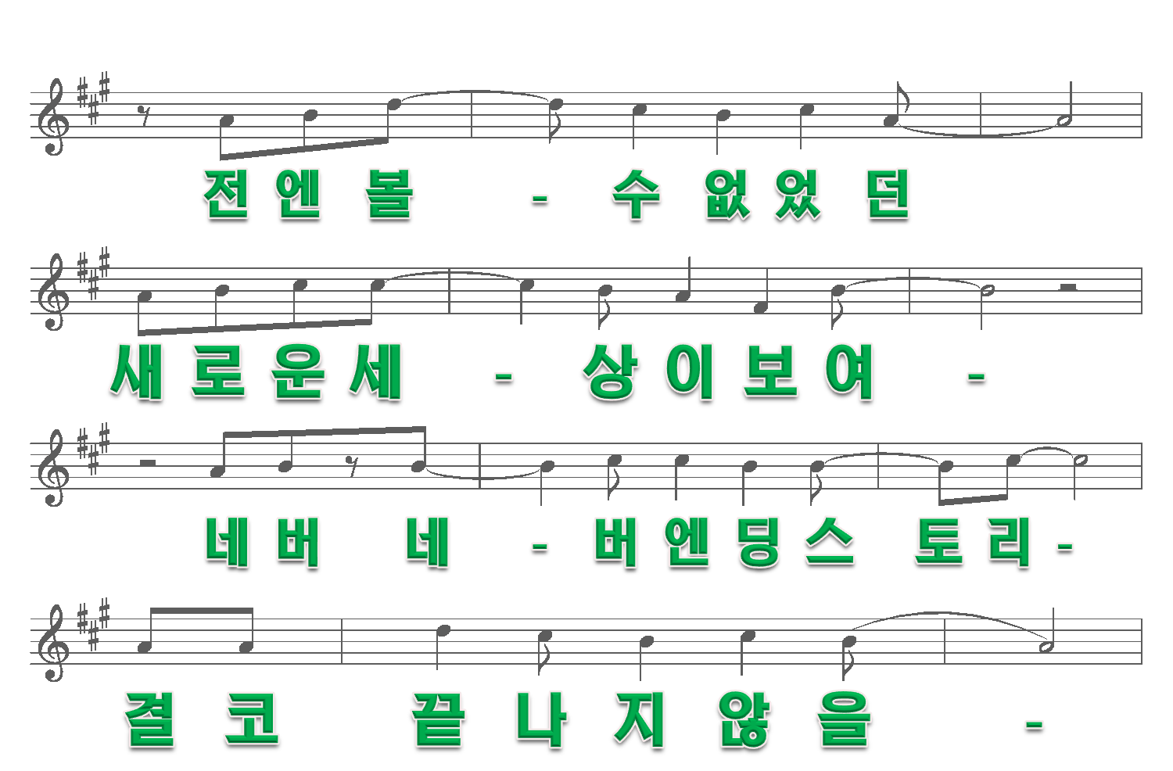
2/3

Slide 3
3/3

