Slide 1
Jump praise
1절
1/12

Slide 2
2/12

Slide 3
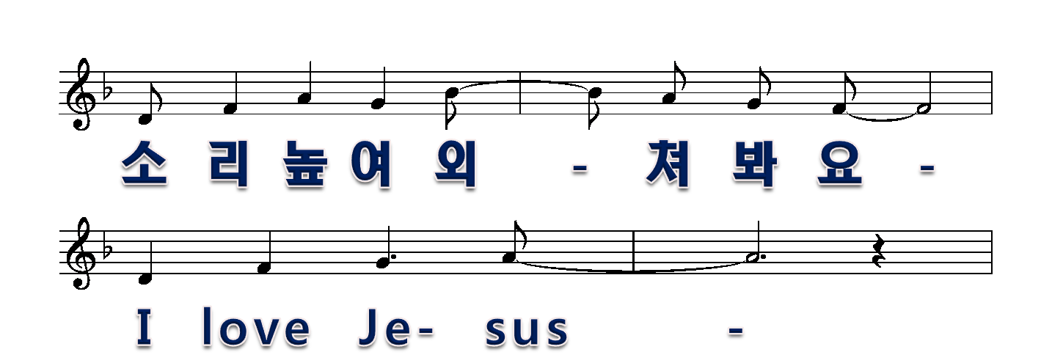
3/12

Slide 4
2절
4/12

Slide 5
5/12

Slide 6
6/12

Slide 7
2절
7/12

Slide 8
2절
8/12

Slide 9
2절
9/12

Slide 10
2절
10/12

Slide 11
2절
11/12

Slide 12
2절
12/12

