Slide 1
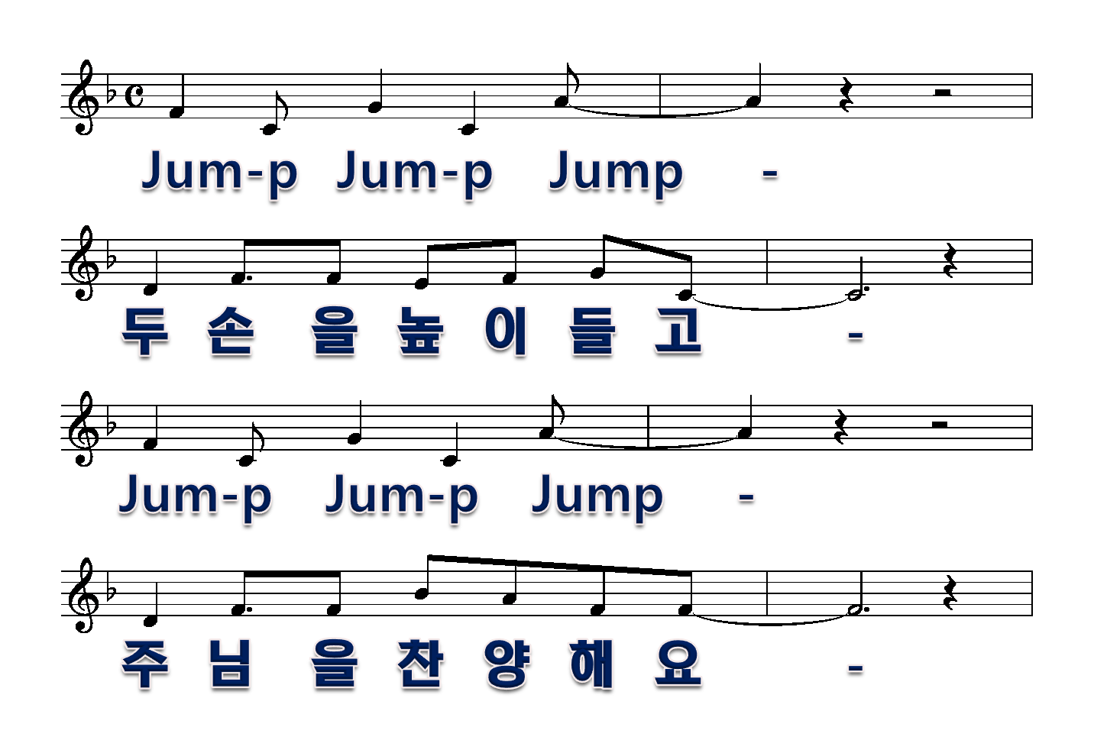
Jump praise
1절
1/6

Slide 2
2/6

Slide 3
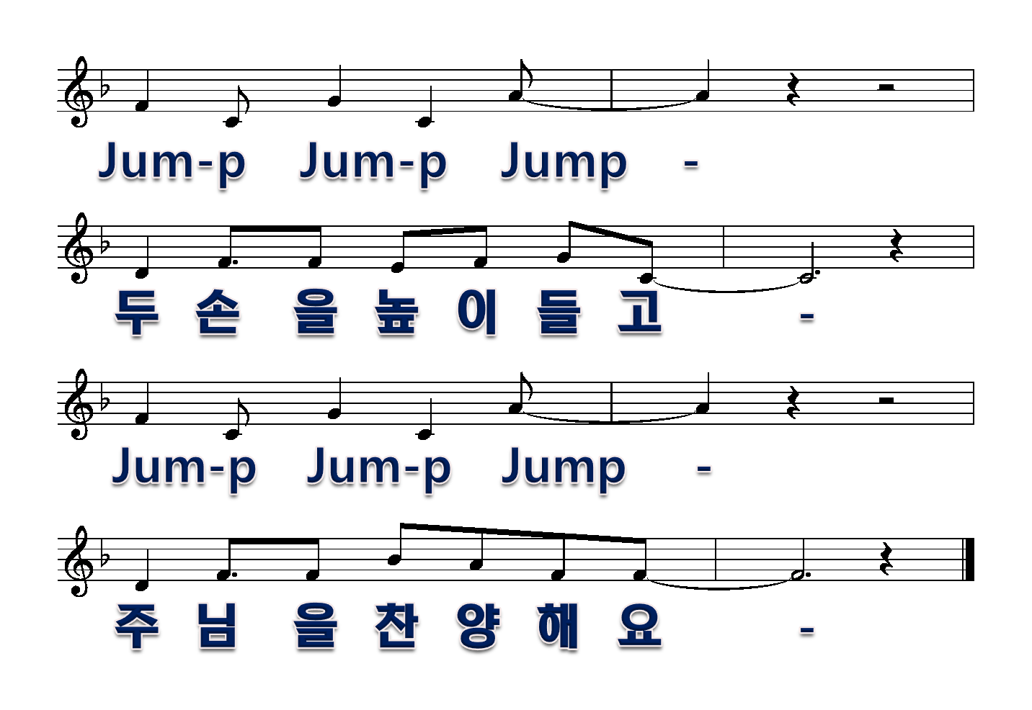
3/6

Slide 4
2절
4/6

Slide 5
5/6

Slide 6
6/6

