Slide 1
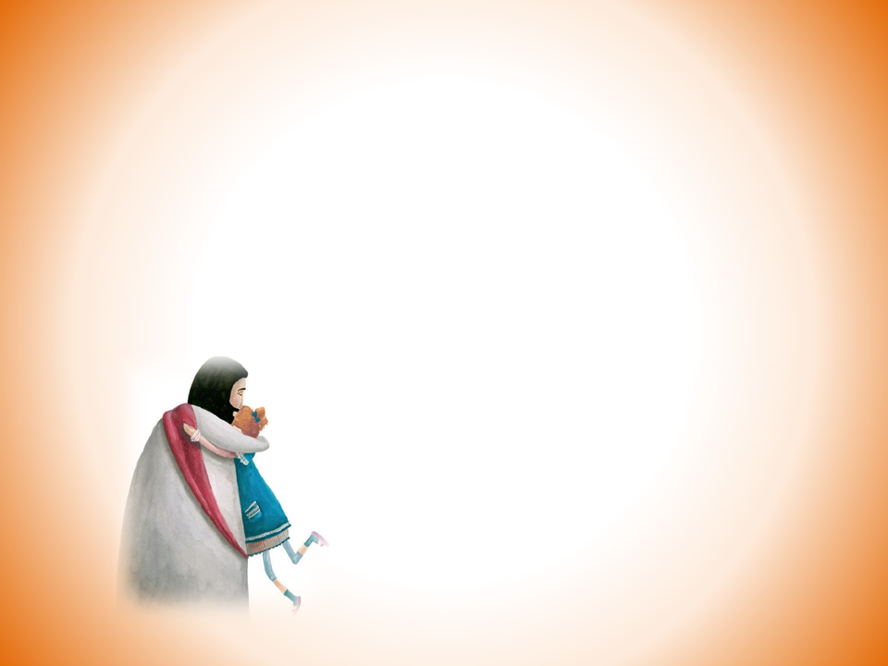

하늘만큼 땅만큼
1/4

Slide 2


2/4

Slide 3


3/4

Slide 4

4/4

