Slide 1
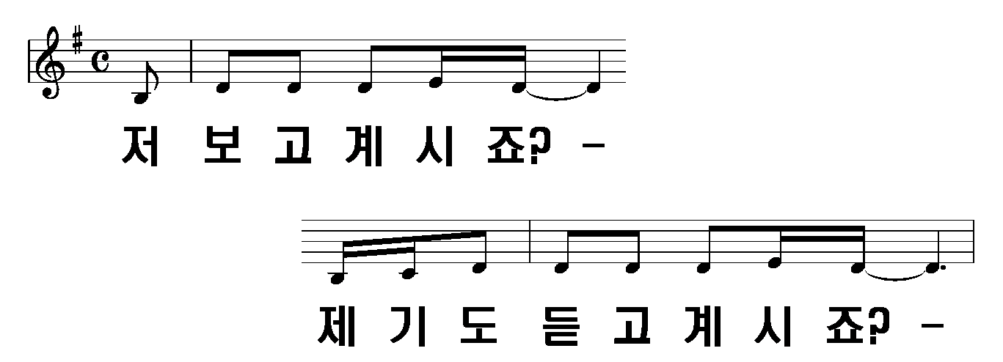
저 보고 계시죠?
1절
1/18

Slide 2
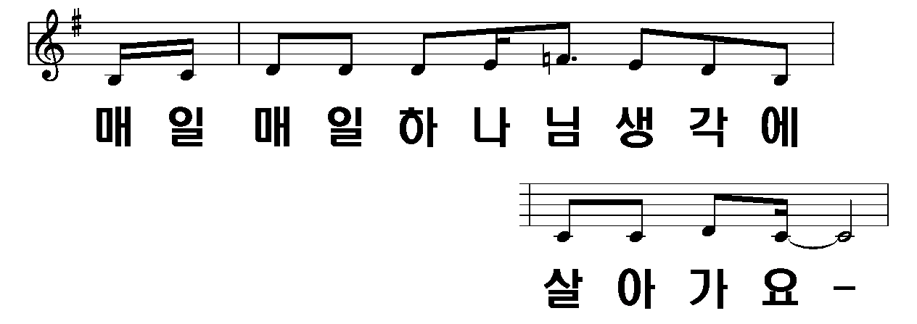
2/18

Slide 3
3/18

Slide 4
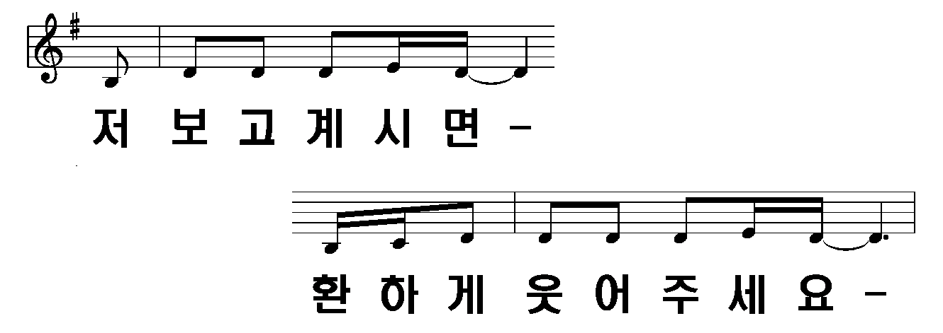
4/18

Slide 5
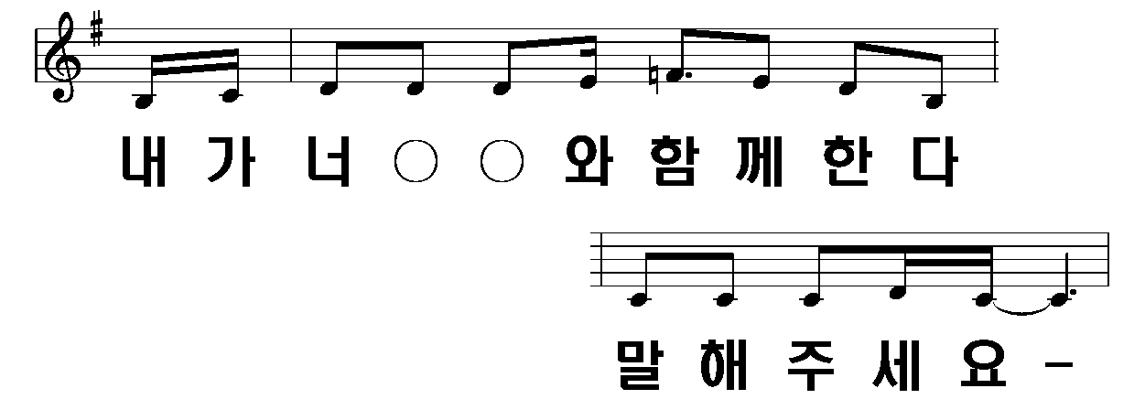
5/18

Slide 6
6/18

Slide 7
7/18

Slide 8
8/18

Slide 9
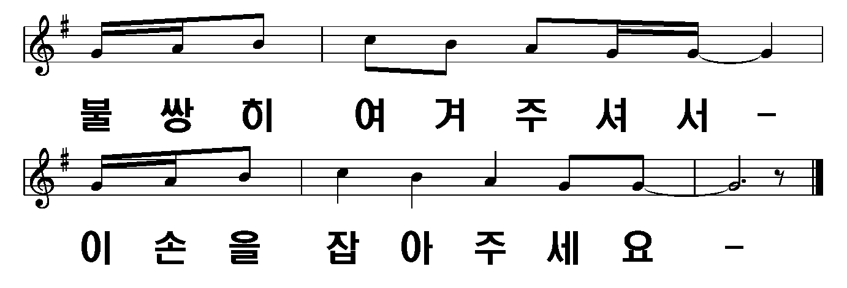
9/18

Slide 10
2절
10/18

Slide 11
11/18

Slide 12
12/18

Slide 13
13/18

Slide 14
14/18

Slide 15
15/18

Slide 16
16/18

Slide 17
17/18

Slide 18
18/18

