Slide 1
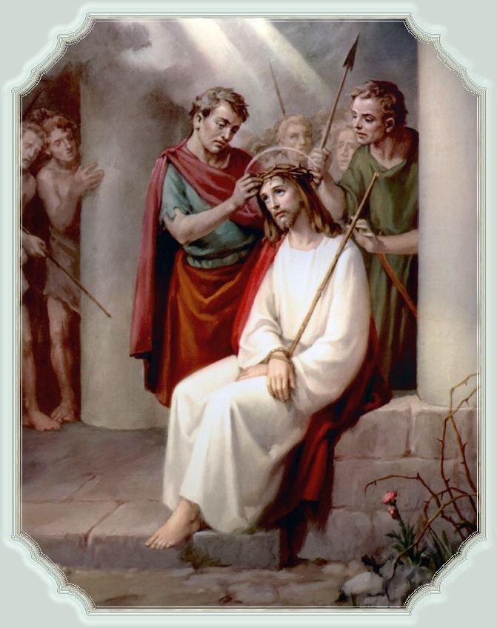
우리 때문에
1/15

Slide 2
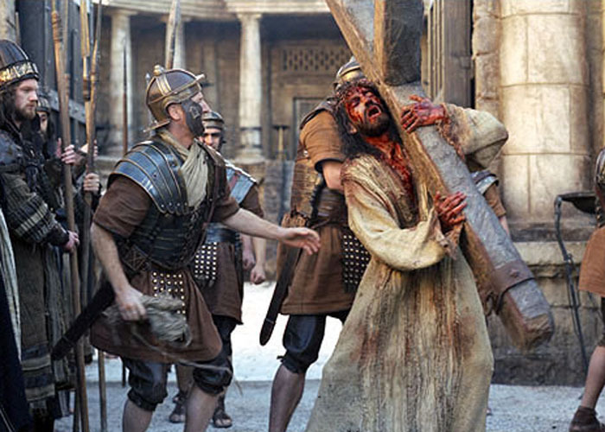
2/15

Slide 3
3/15

Slide 4
4/15

Slide 5
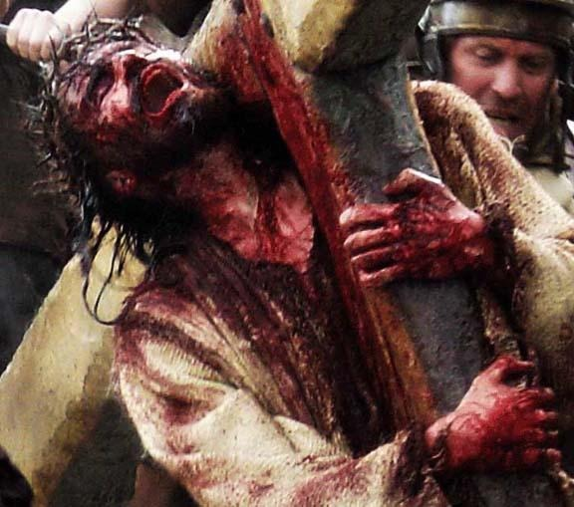
5/15

Slide 6
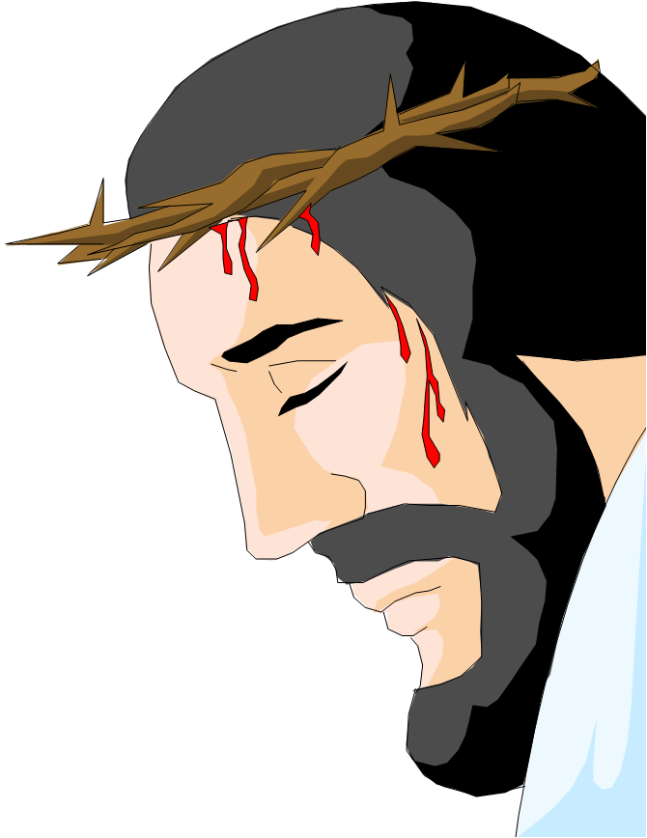
6/15

Slide 7
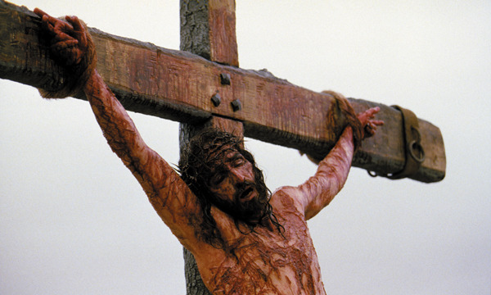
7/15

Slide 8
8/15

Slide 9
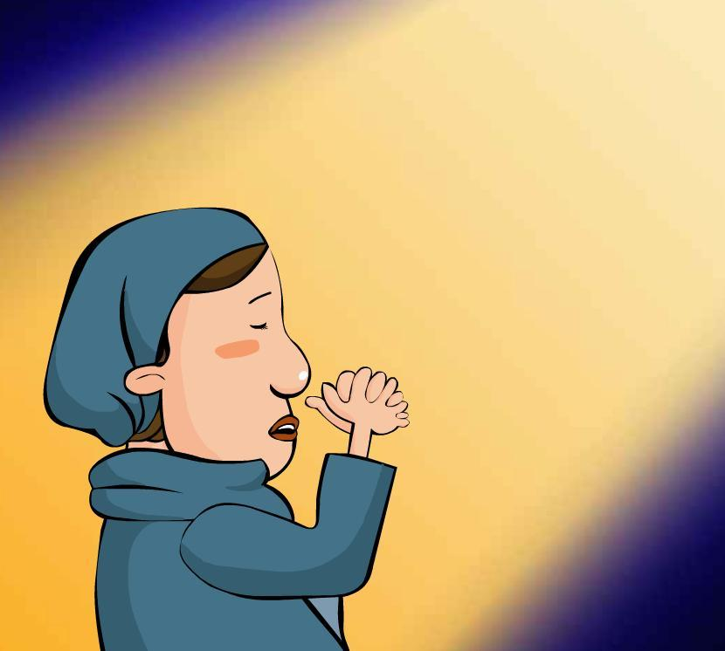
9/15

Slide 10
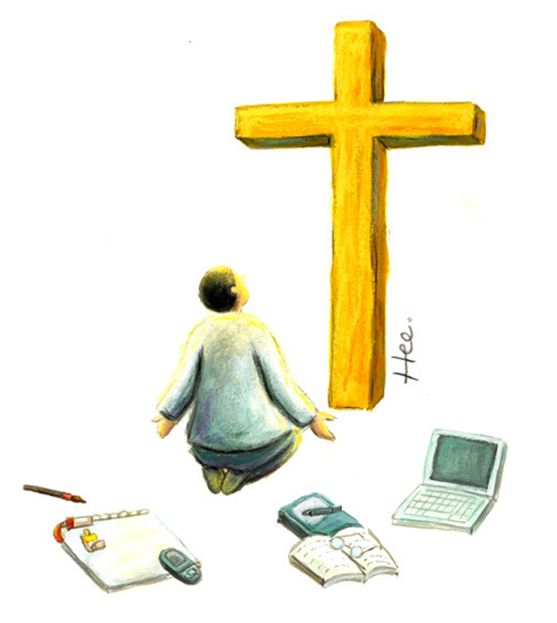
10/15

Slide 11
11/15

Slide 12
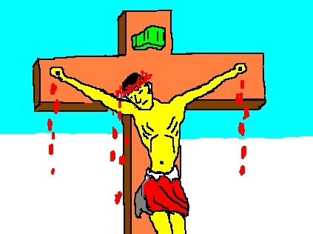
12/15

Slide 13
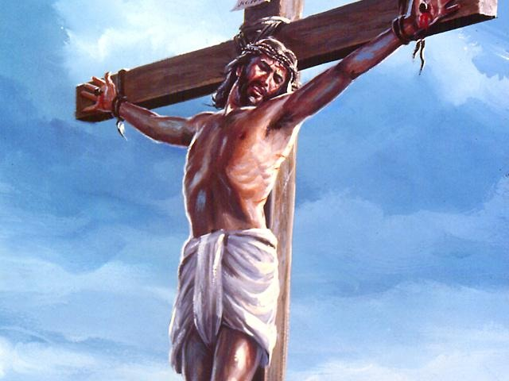
13/15

Slide 14
14/15

Slide 15
15/15

