Slide 1
오직 주님만
1/13

Slide 2
2/13

Slide 3
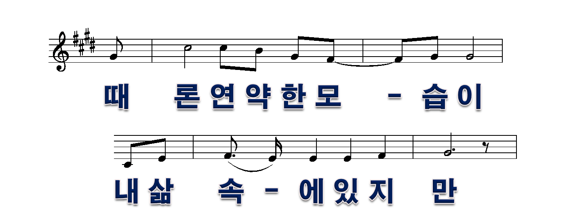
3/13

Slide 4
4/13

Slide 5
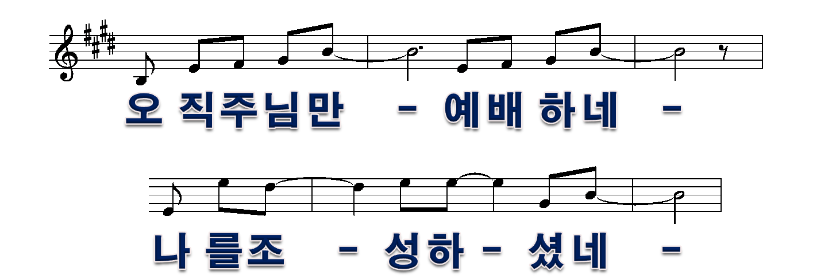
5/13

Slide 6
6/13

Slide 7
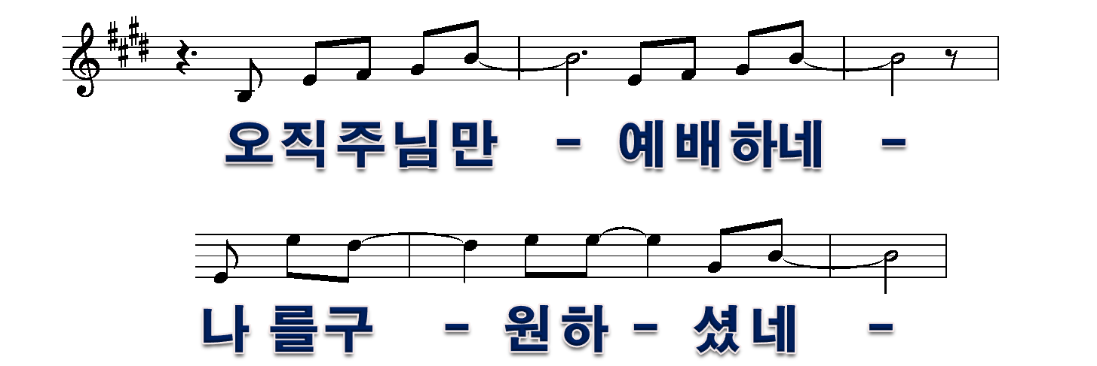
7/13

Slide 8
8/13

Slide 9
9/13

Slide 10
10/13

Slide 11
11/13

Slide 12
12/13

Slide 13
13/13

