Slide 1
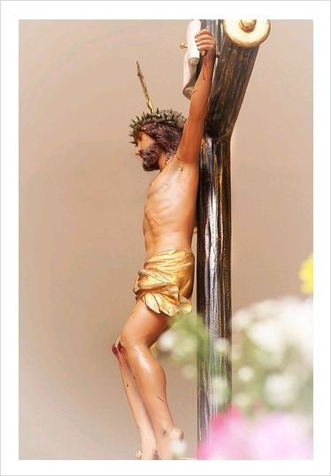
오! 예수님
1/7

Slide 2
2/7

Slide 3
3/7

Slide 4
4/7

Slide 5
5/7

Slide 6
6/7

Slide 7
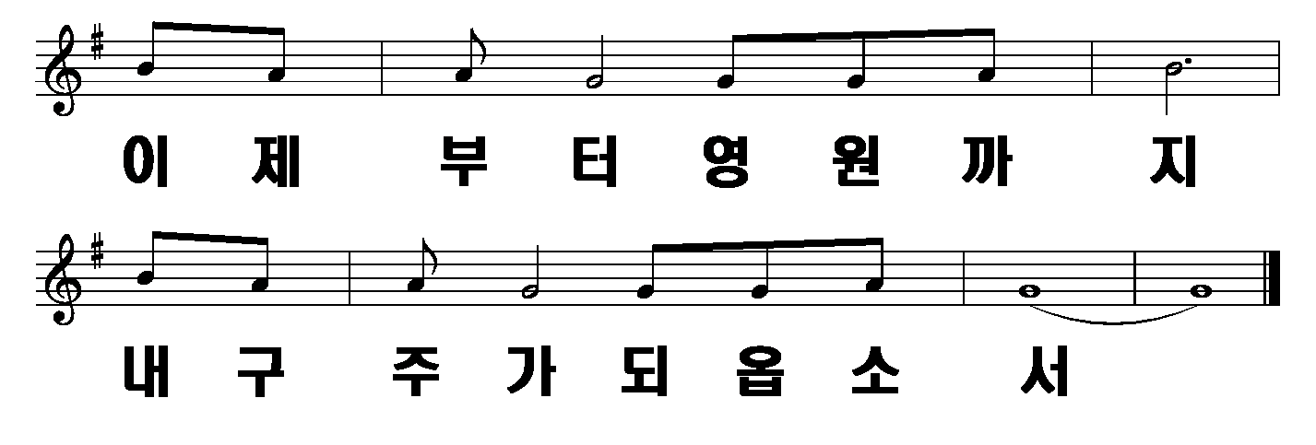
7/7

