Slide 1
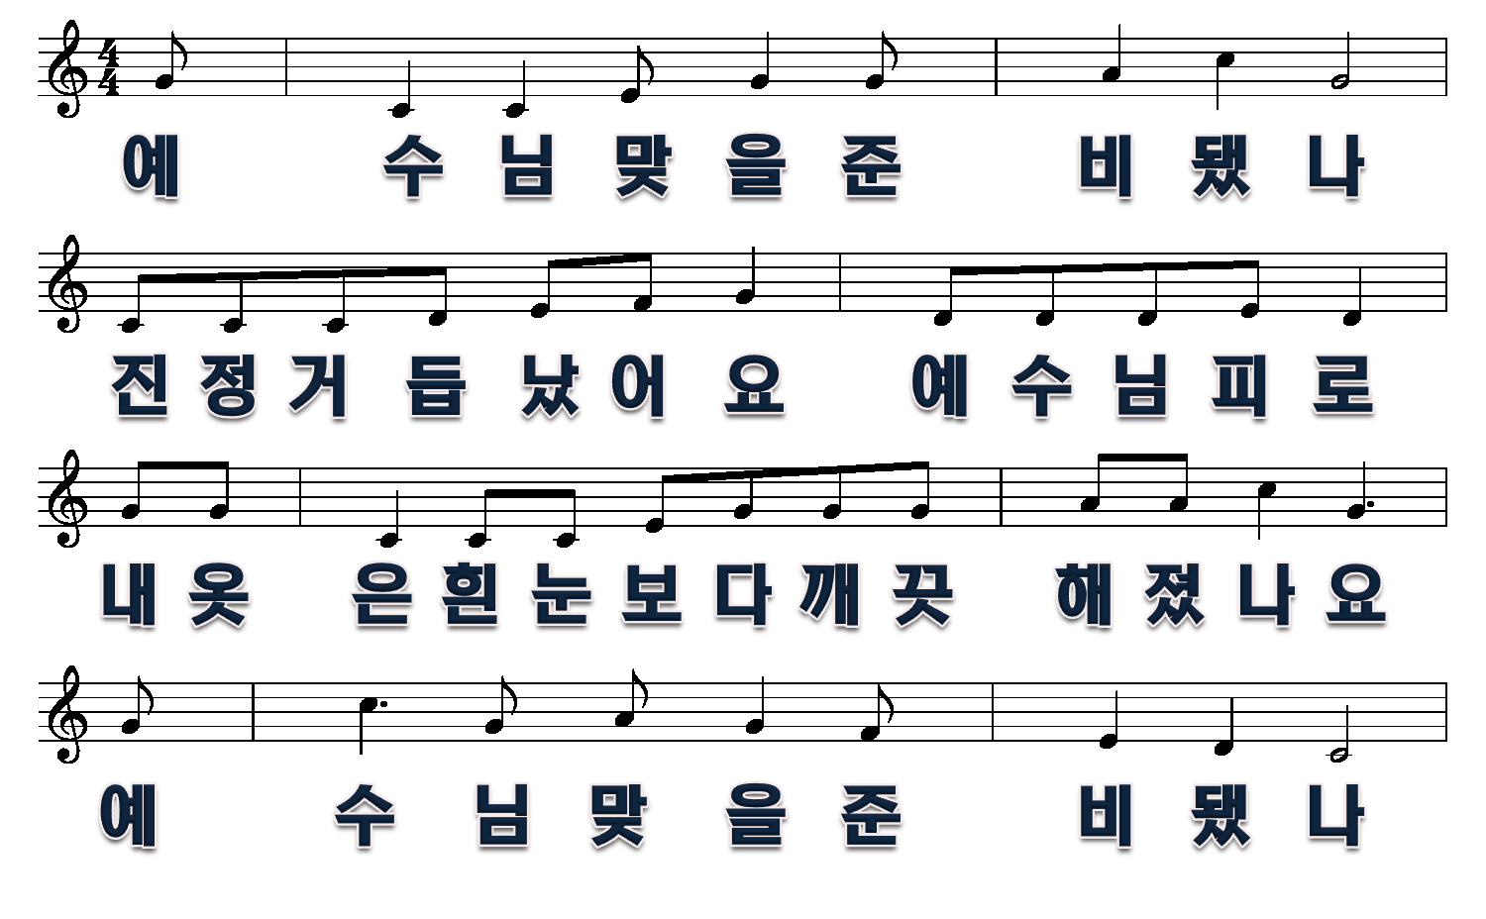
예수님 맞을 준비됐나
1절
1/6

Slide 2
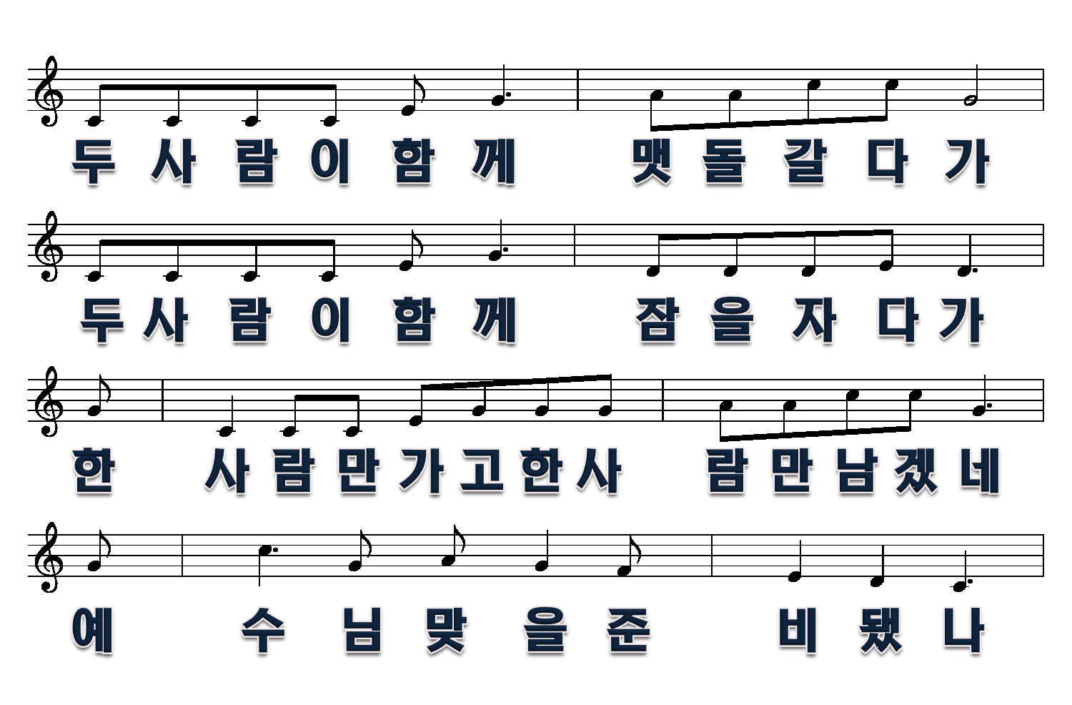
2/6

Slide 3
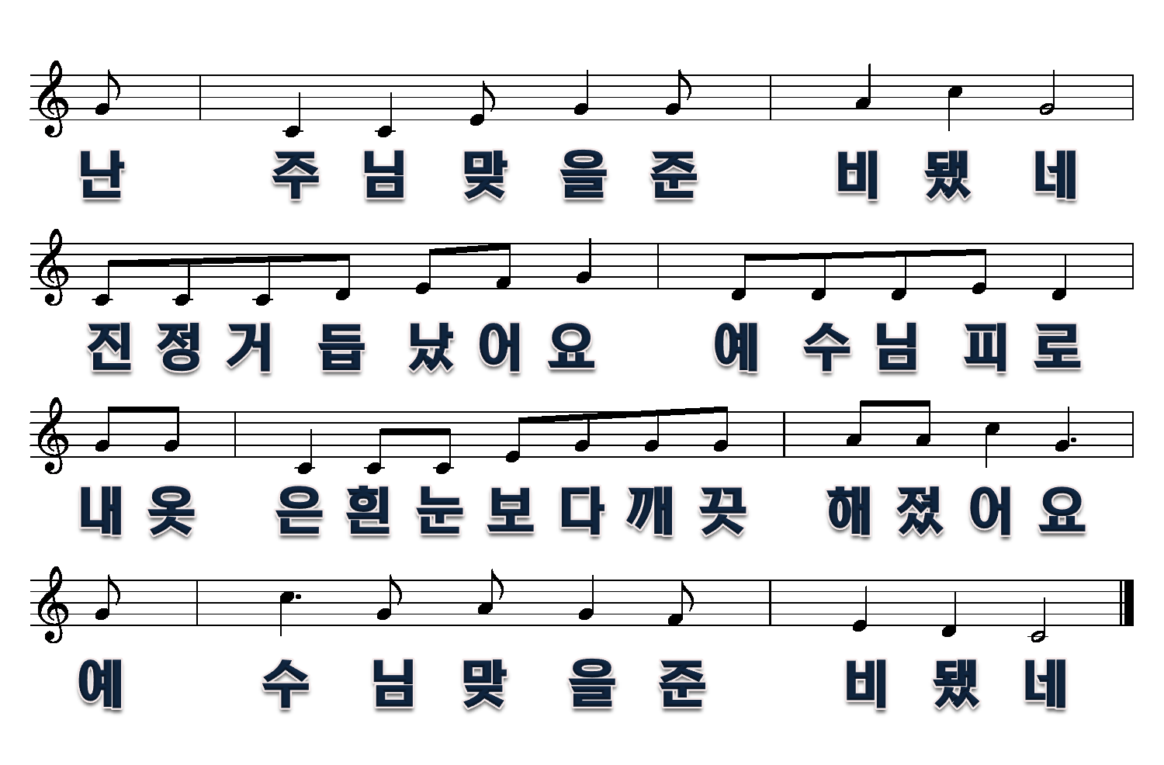
3/6

Slide 4
2절
4/6

Slide 5
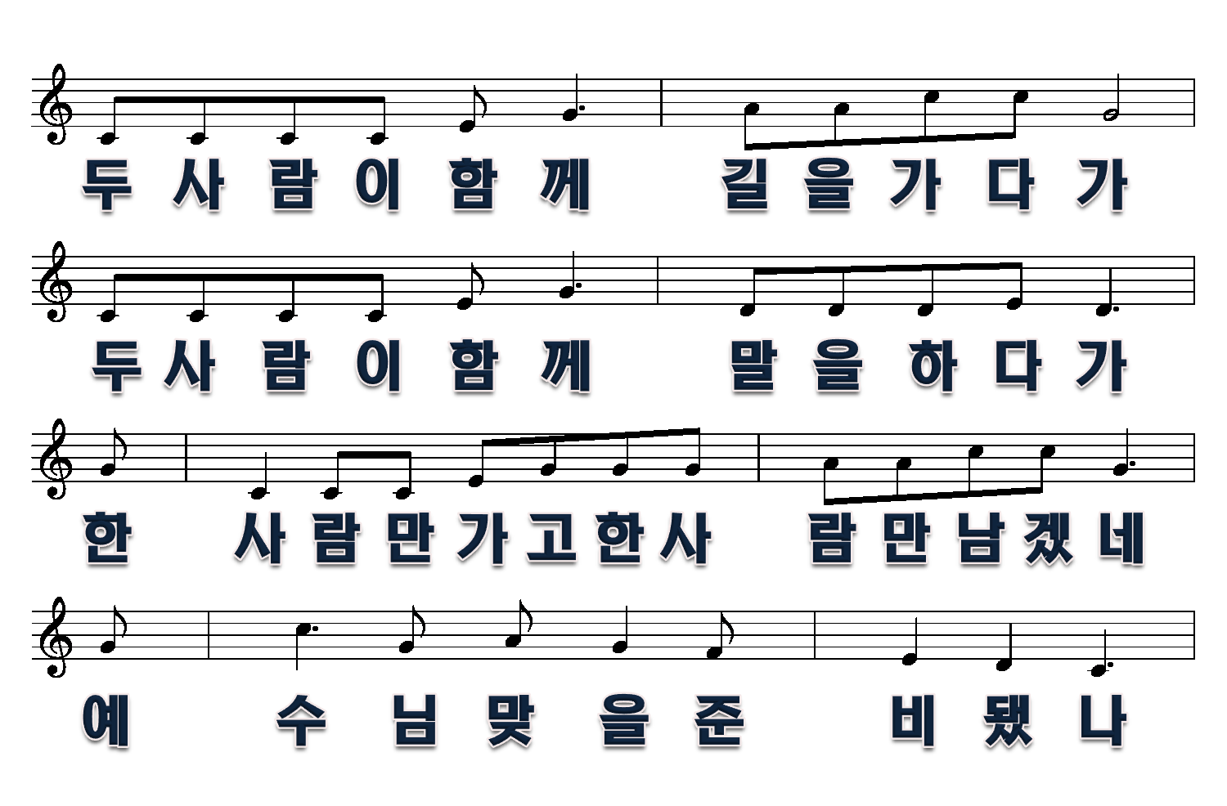
5/6

Slide 6
6/6

