Slide 1
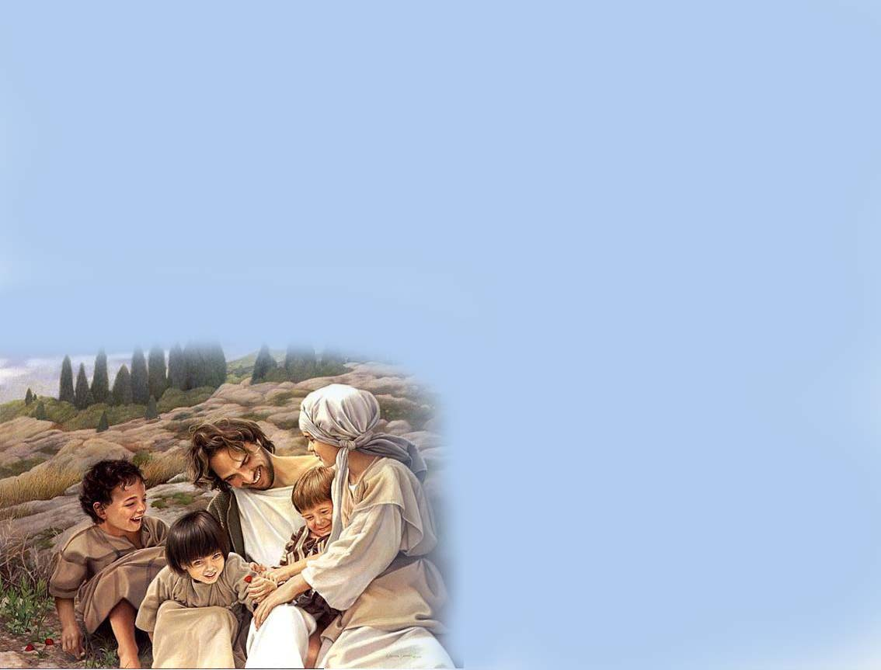
The Garden of Lord
Church

Slide 2
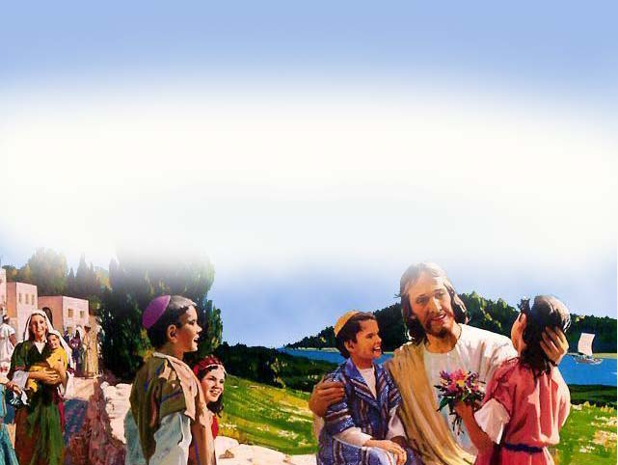
The Garden of Lord
Church

Slide 3
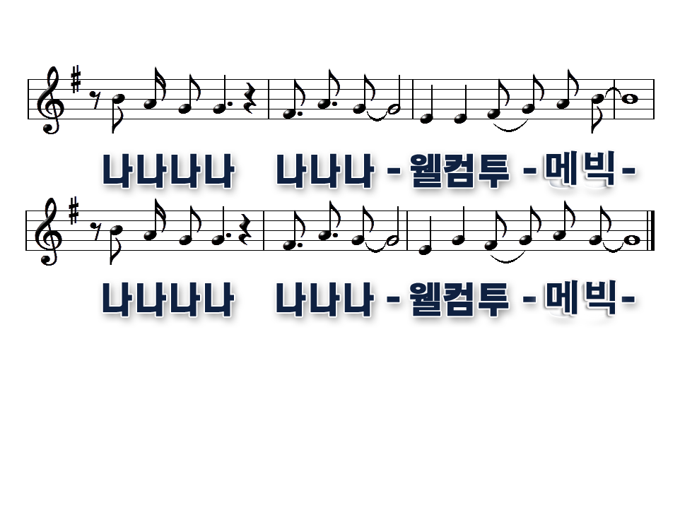
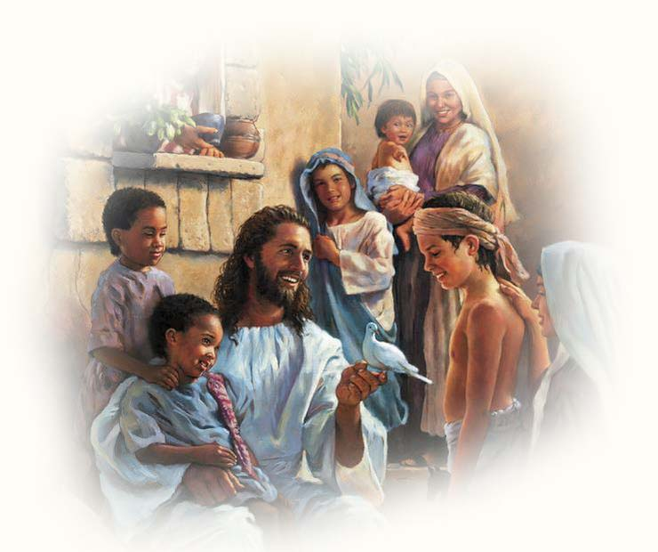
The Garden of Lord
Church

Slide 4
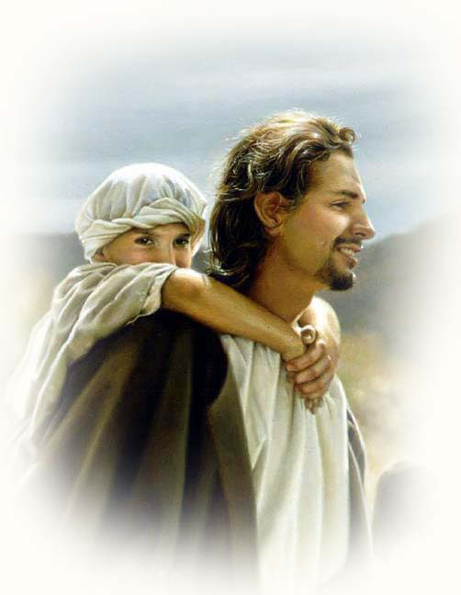
The Garden of Lord
Church

Slide 5
The Garden of Lord
Church

Slide 6
The Garden of Lord
Church

