Slide 1
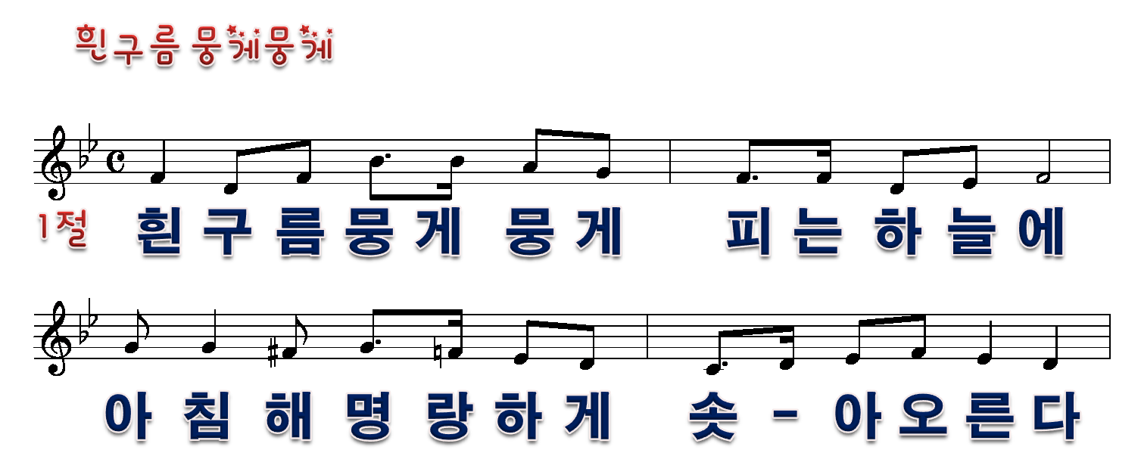
1/9

Slide 2
2/9

Slide 3
3/9

Slide 4
4/9

Slide 5
5/9

Slide 6
6/9

Slide 7
7/9

Slide 8
8/9

Slide 9
9/9

