Slide 1
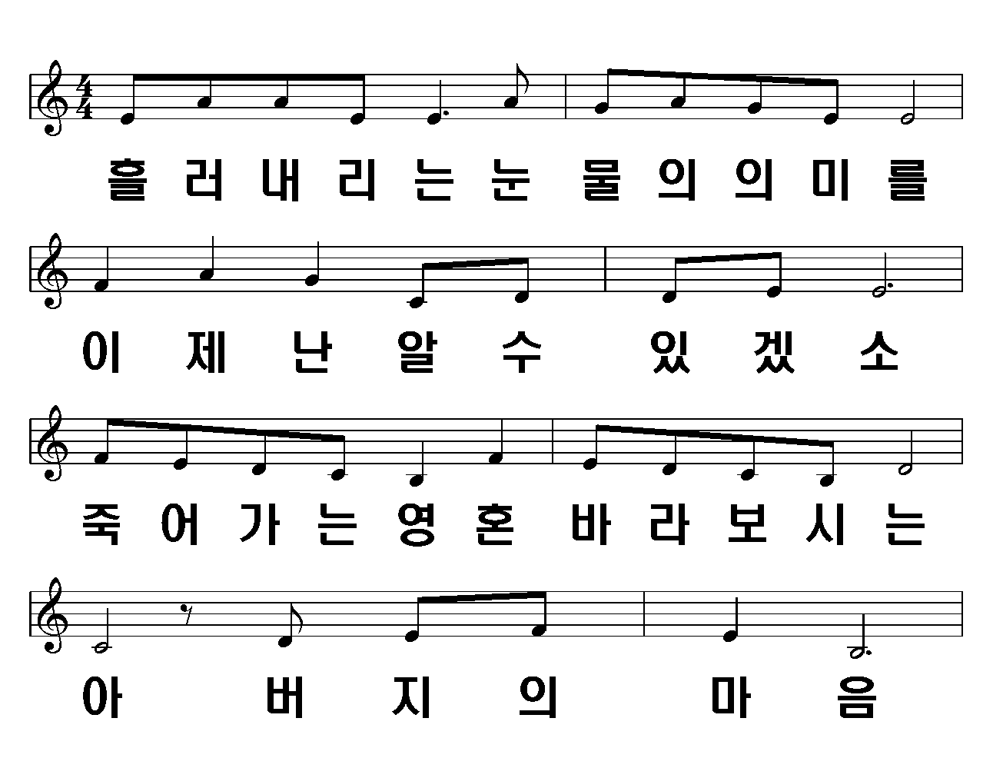
사모곡
1/7

Slide 2
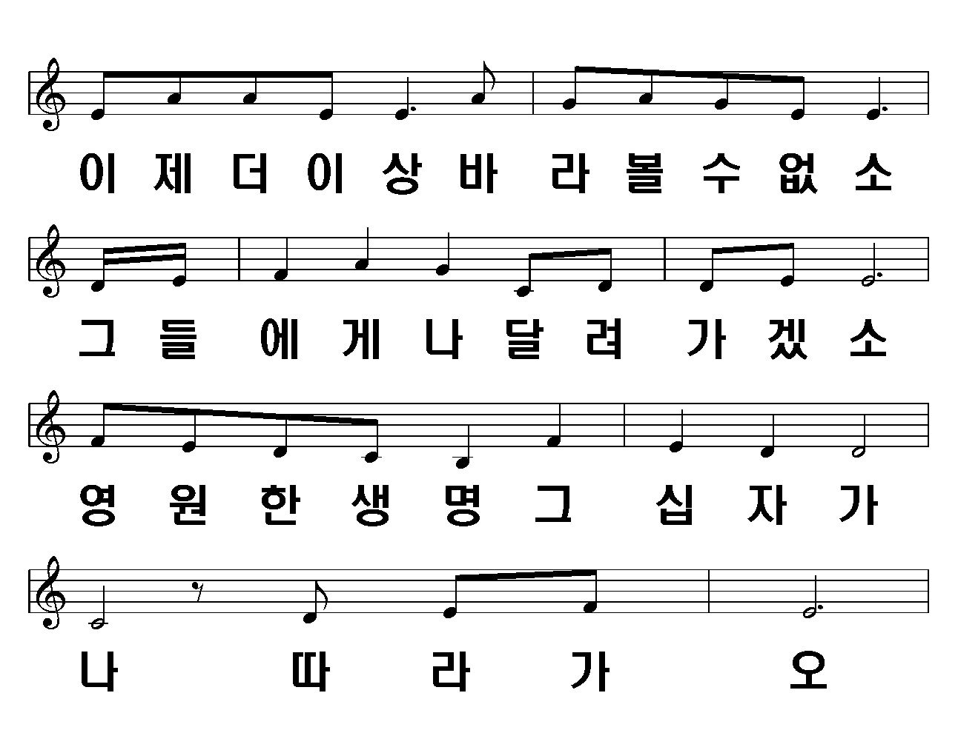
2/7

Slide 3
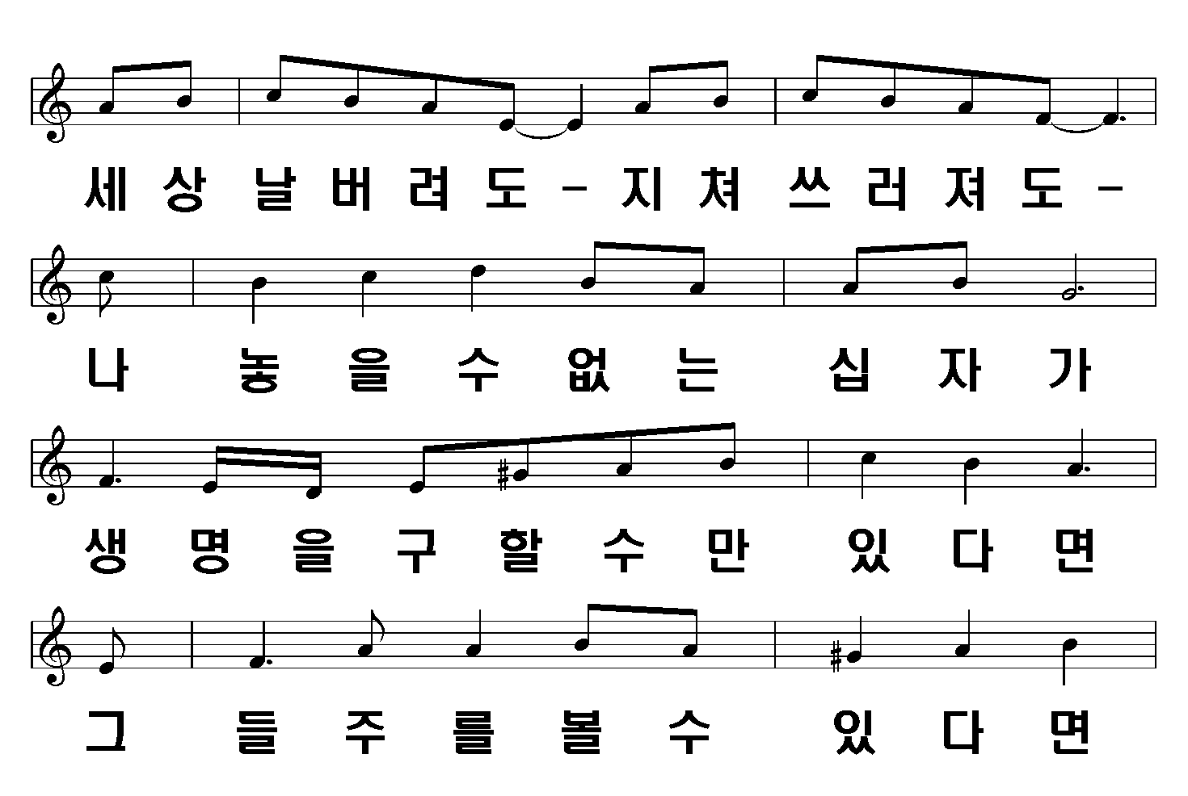
3/7

Slide 4
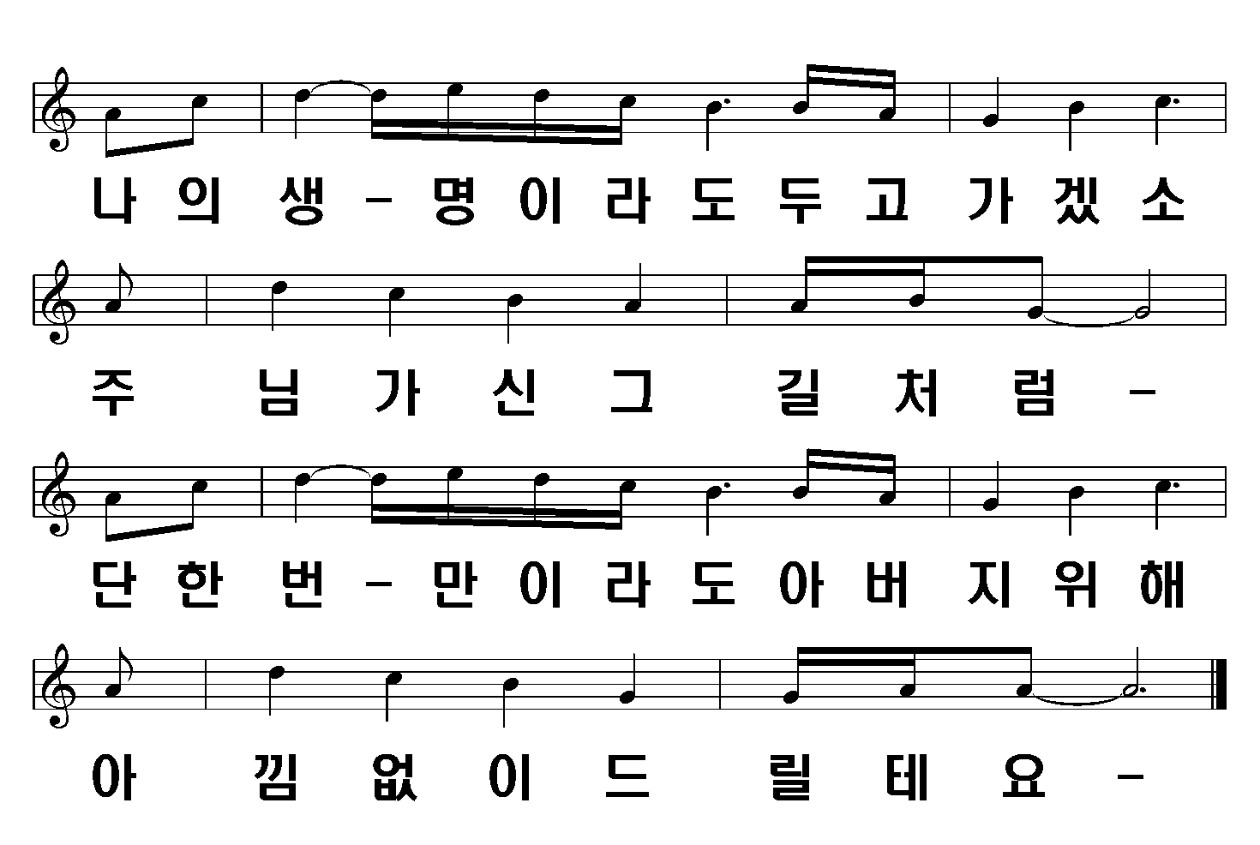
4/7

Slide 5
5/7

Slide 6
6/7

Slide 7
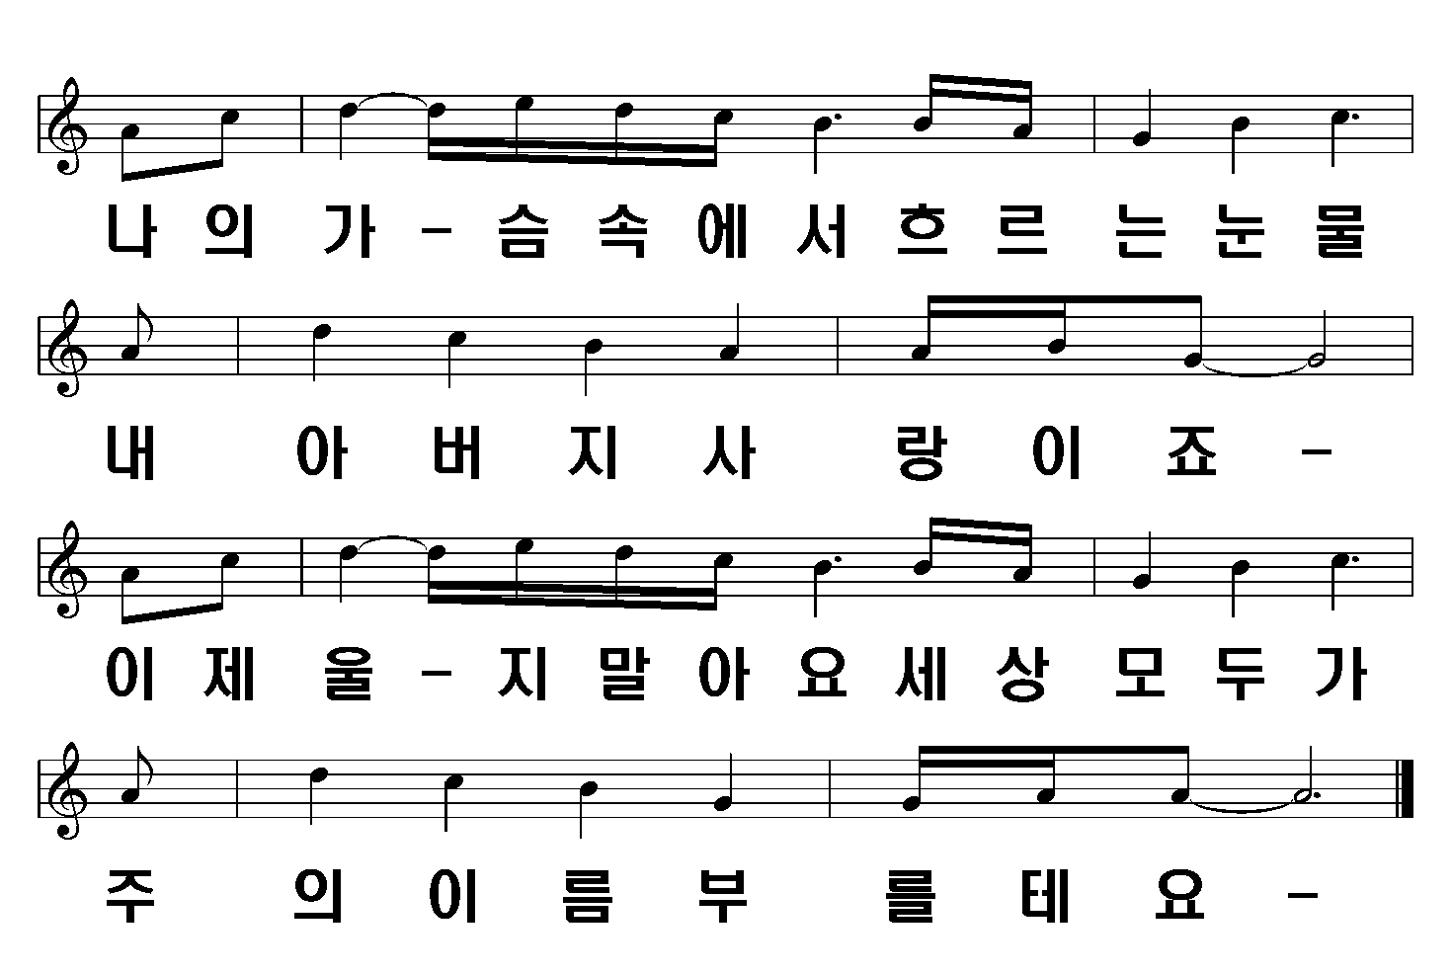
7/7

