Slide 1
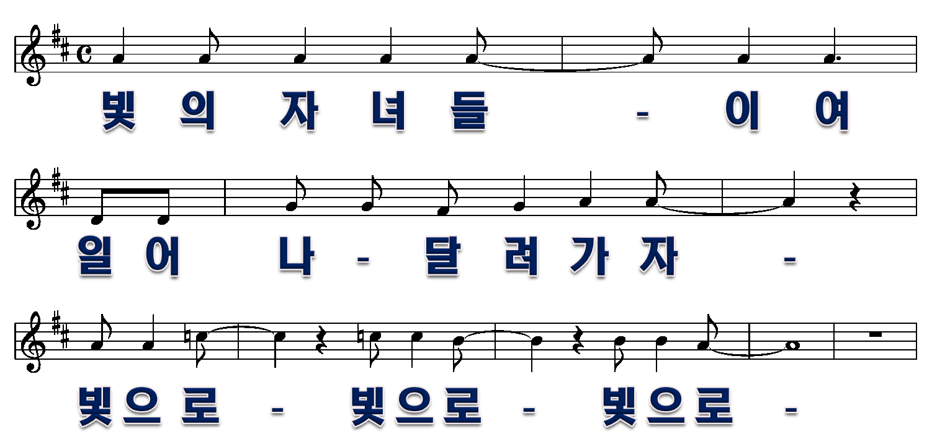
빛으로
1절
1/10

Slide 2
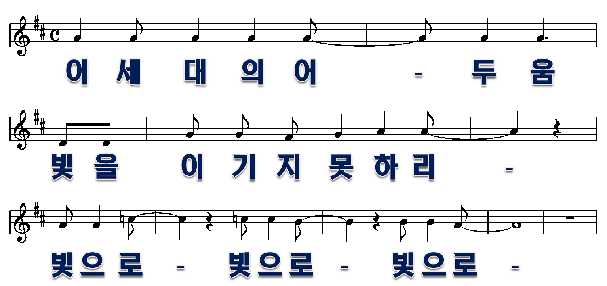
2/10

Slide 3
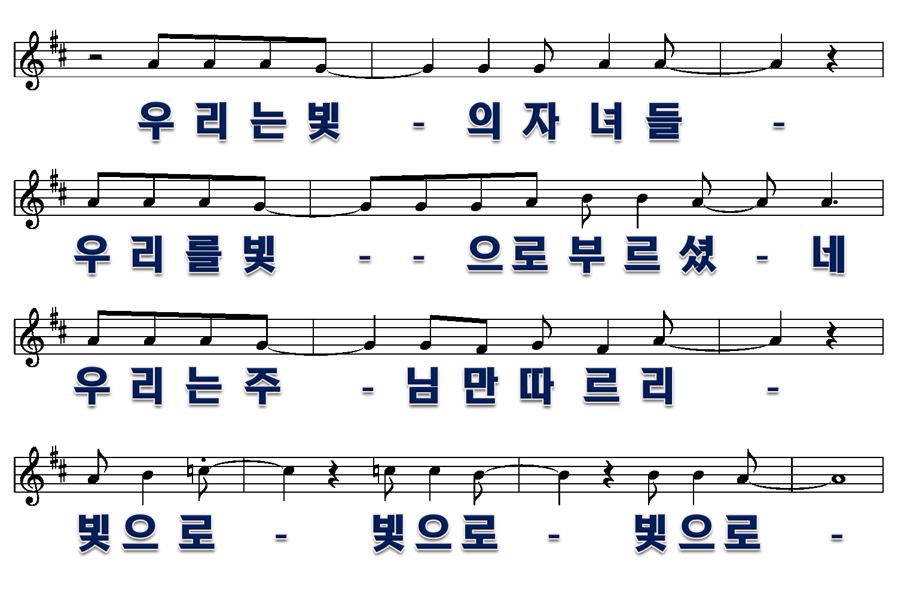
3/10

Slide 4
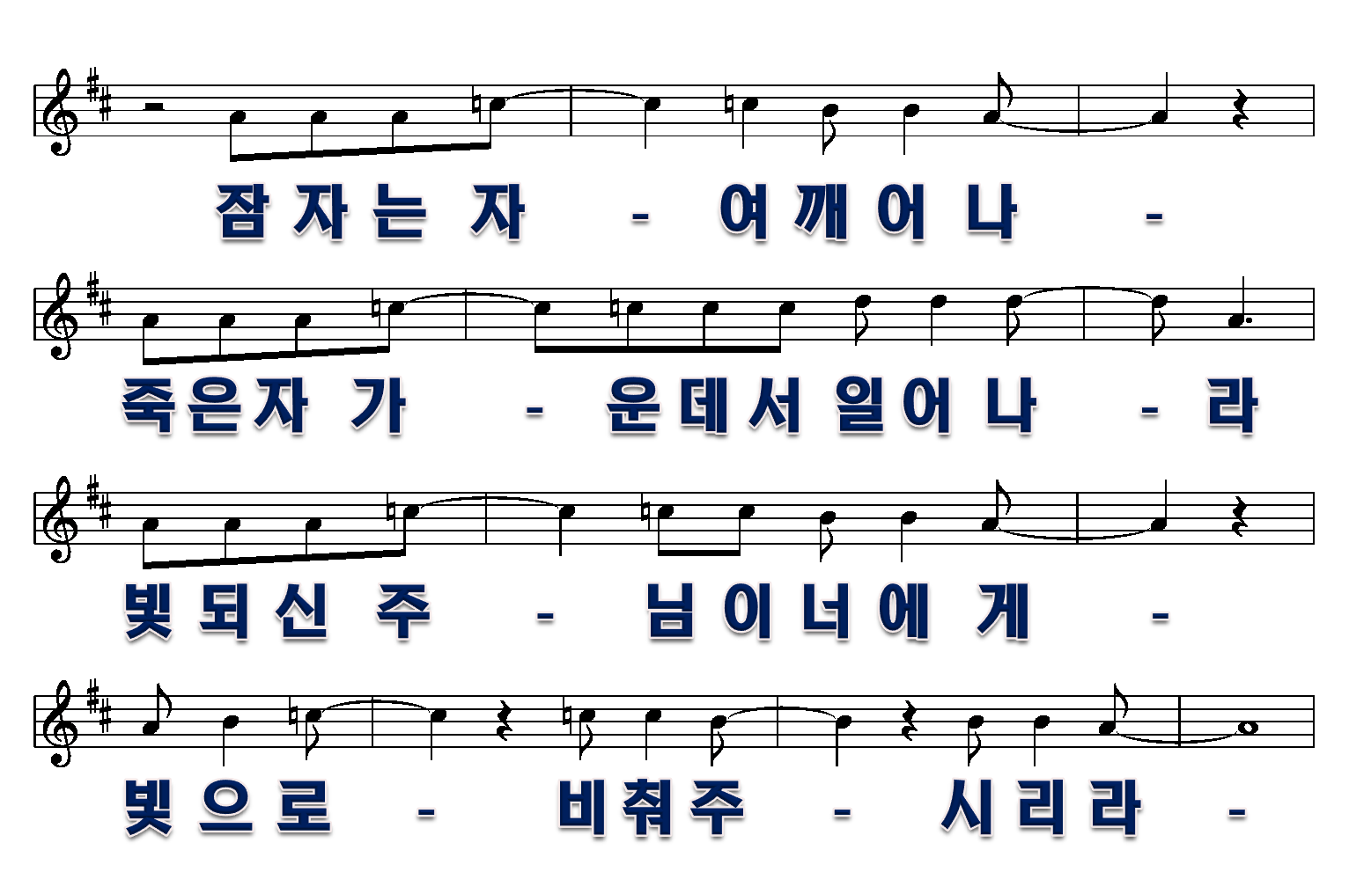
4/10

Slide 5
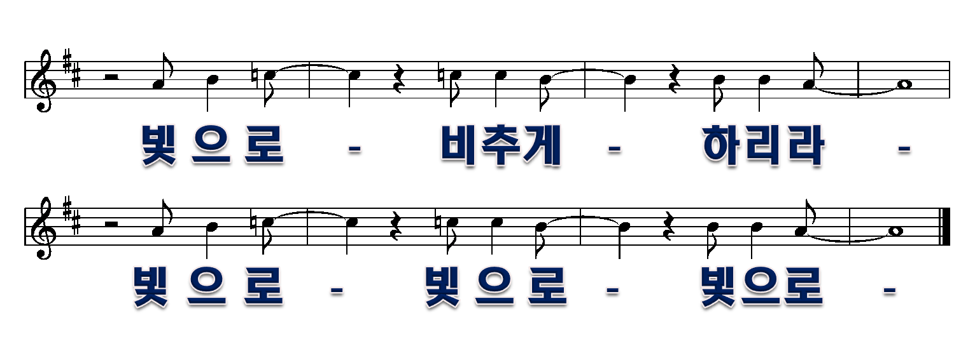
5/10

Slide 6
2절
6/10

Slide 7
7/10

Slide 8
8/10

Slide 9
9/10

Slide 10
10/10

