Slide 1
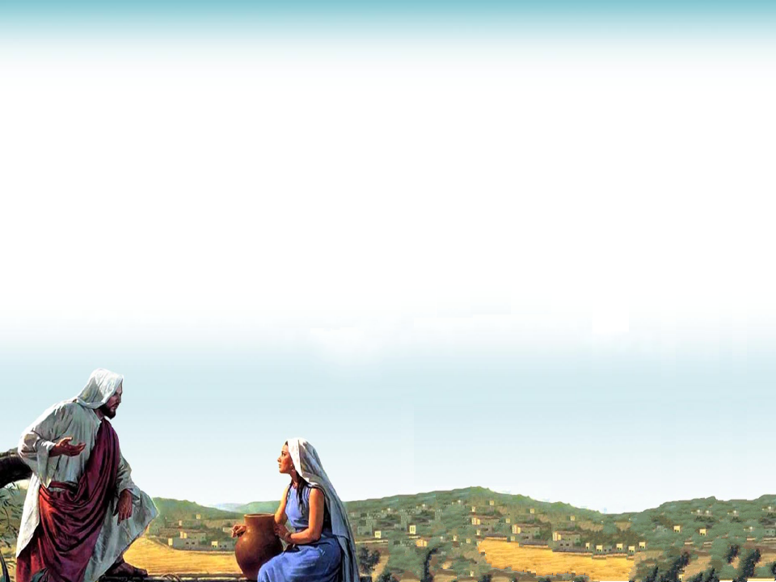

1/7

Slide 2

2/7

Slide 3


3/7

Slide 4
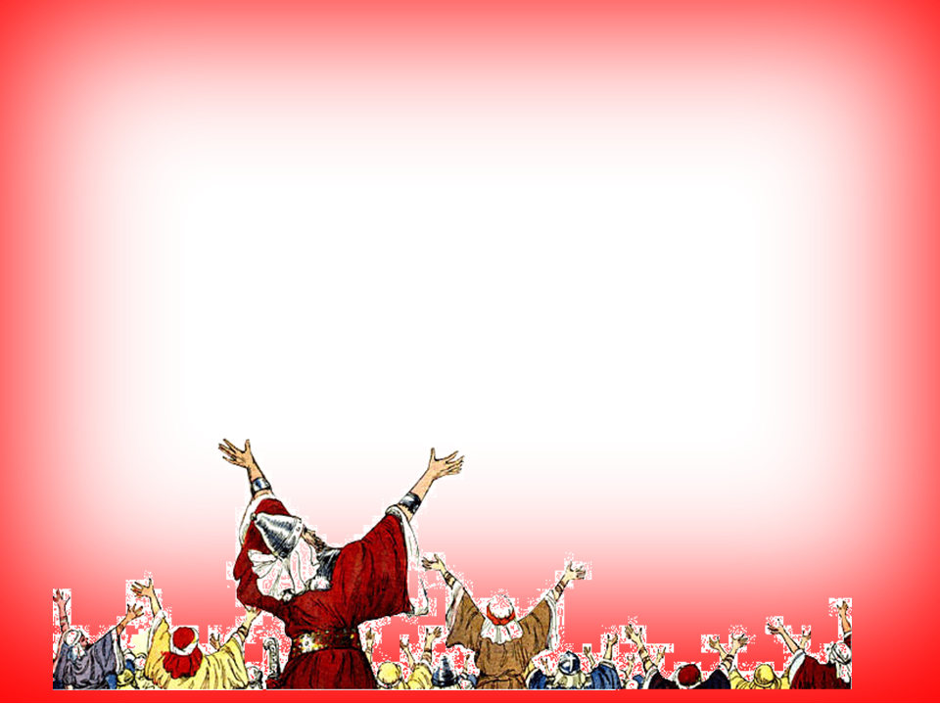

4/7

Slide 5


5/7

Slide 6

6/7

Slide 7
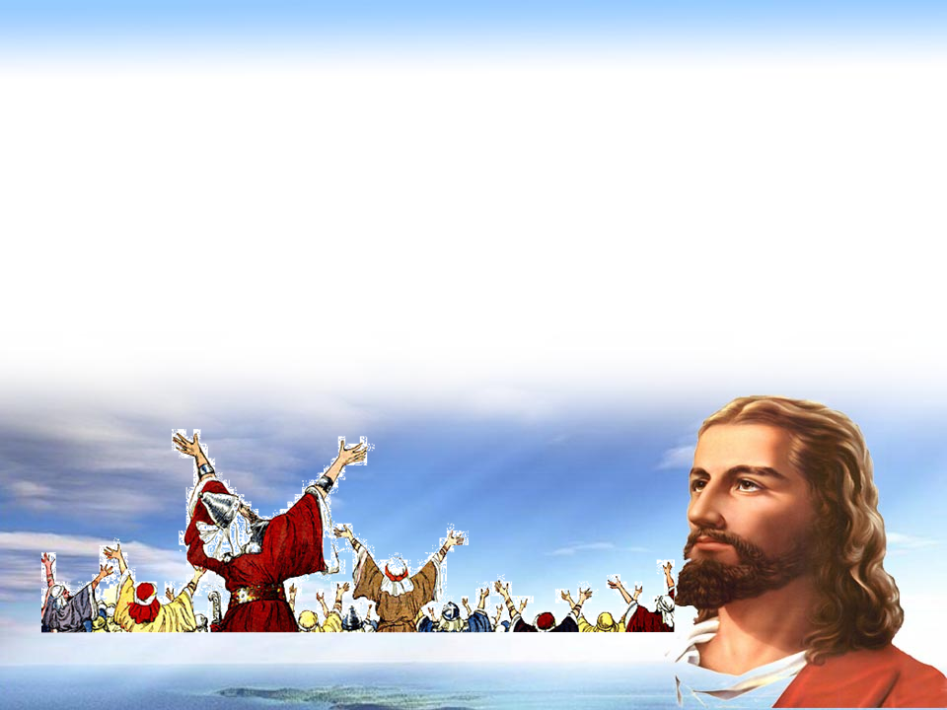
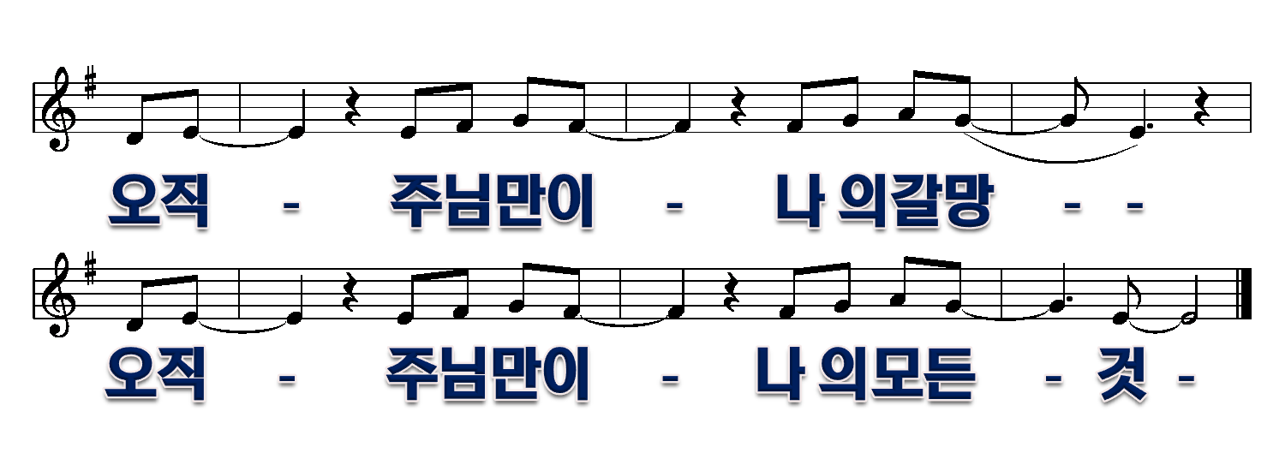
7/7

