Slide 1
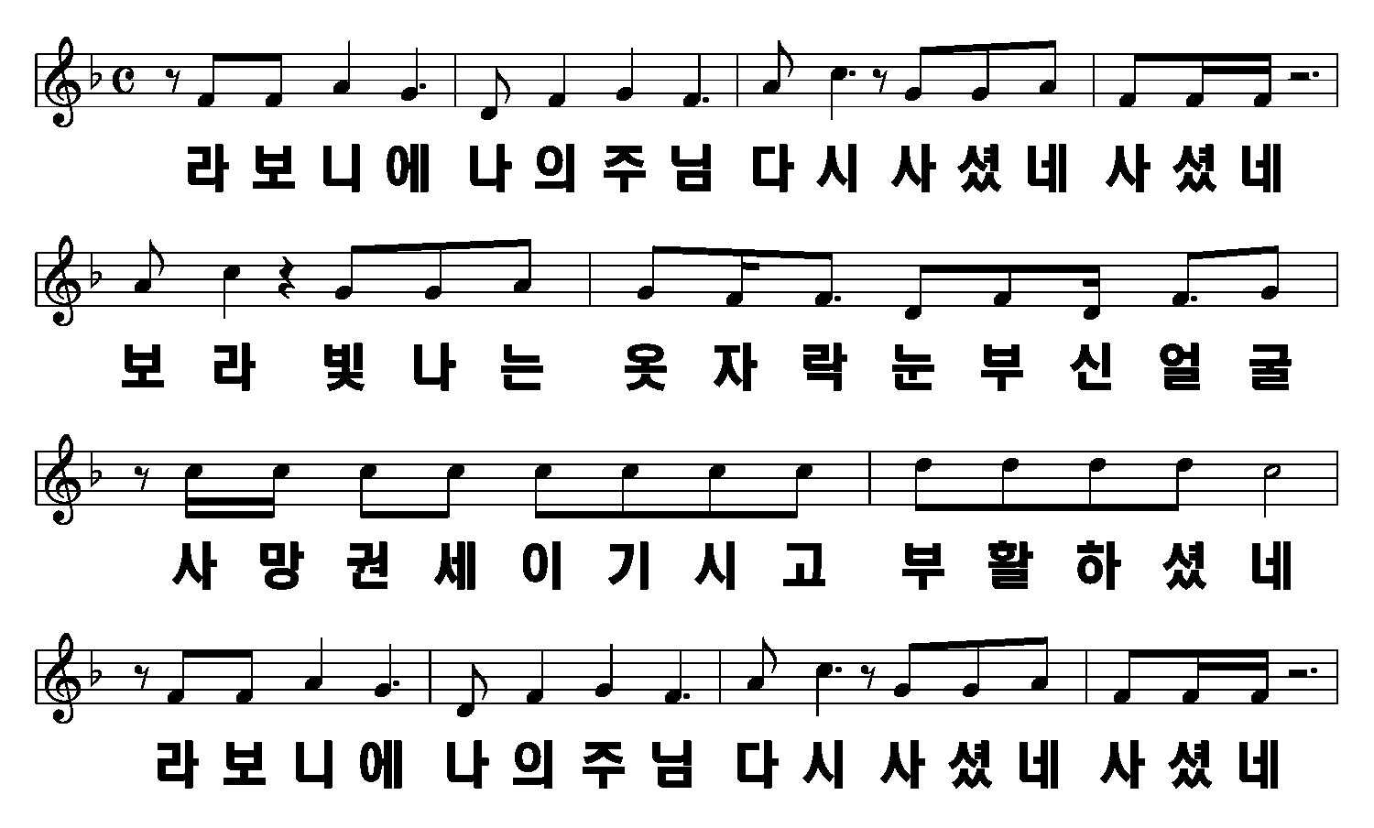
라보니에
1절
1/6

Slide 2
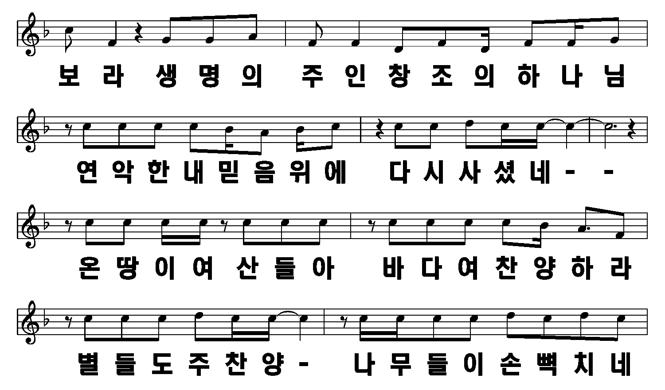
2/6

Slide 3
3/6

Slide 4
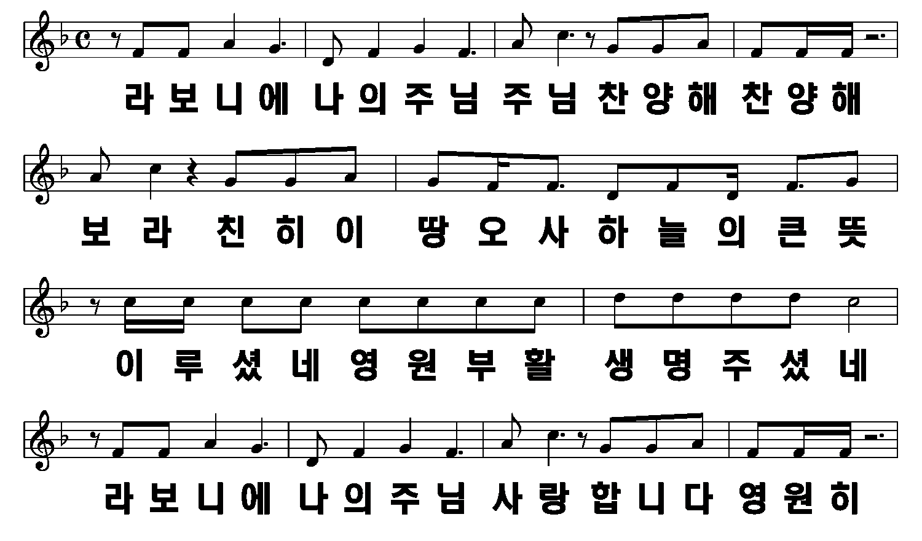
2절
4/6

Slide 5
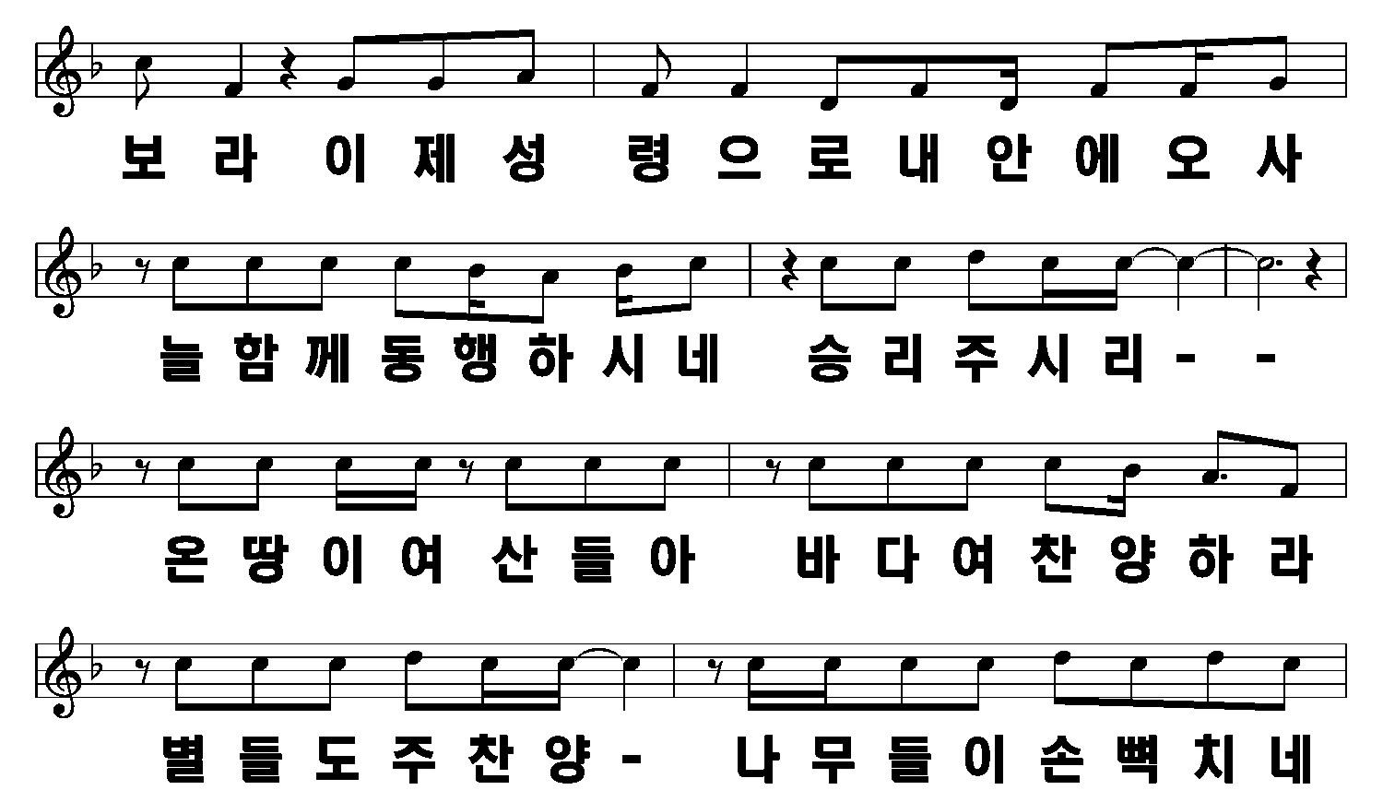
5/6

Slide 6
6/6

