Slide 1
두 발자국
1절
1/6

Slide 2
2/6

Slide 3
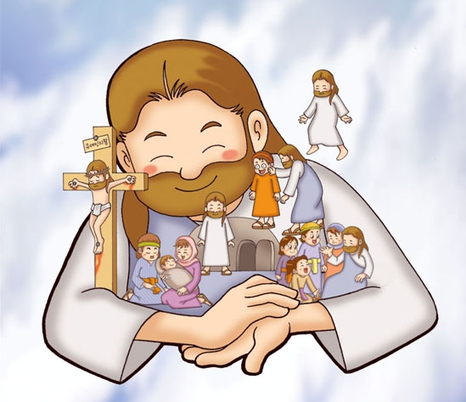
2절
3/6

Slide 4
4/6

Slide 5
3절
5/6

Slide 6
6/6

