Slide 1
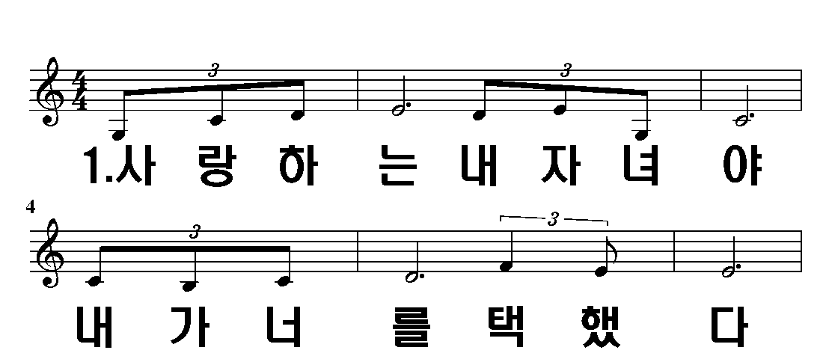
내가 너를 택했다
1 – 1
2 - 5
3 - 9
1/12

Slide 2
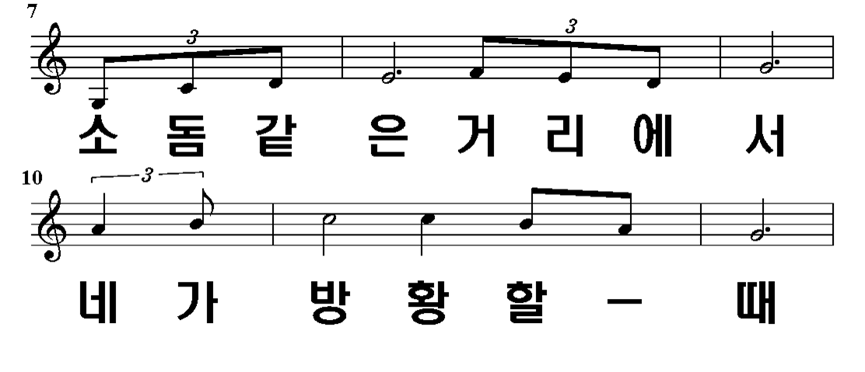
1 – 1
2 - 5
3 - 9
2/12

Slide 3
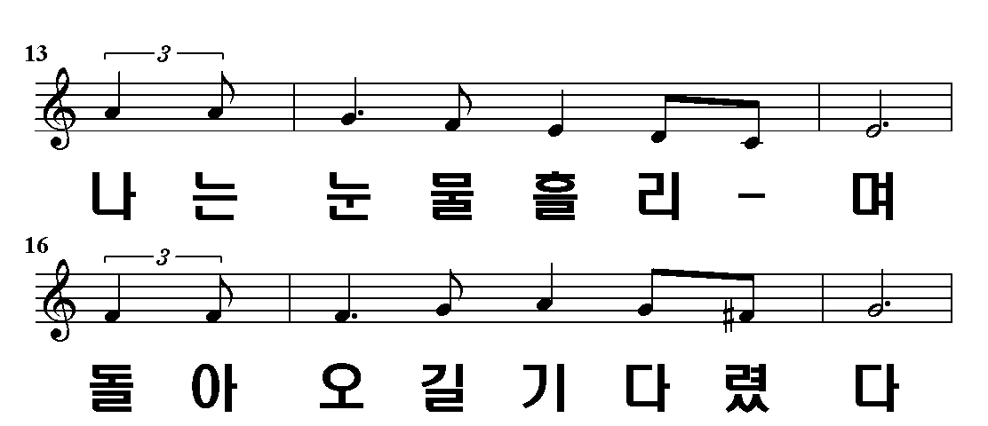
1 – 1
2 - 5
3 - 9
3/12

Slide 4
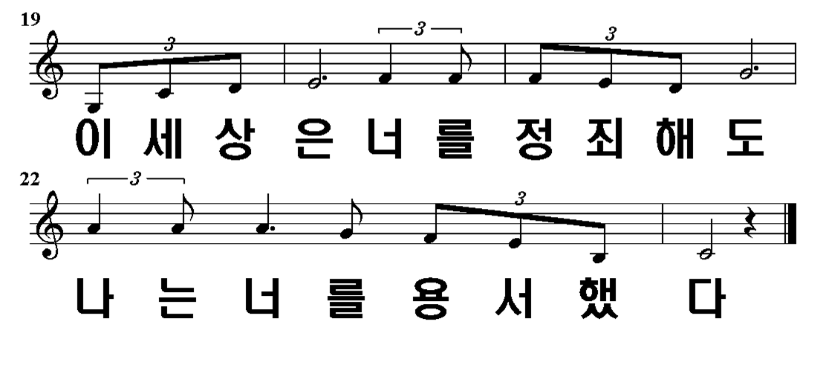
1 – 1
2 - 5
3 - 9
4/12

Slide 5
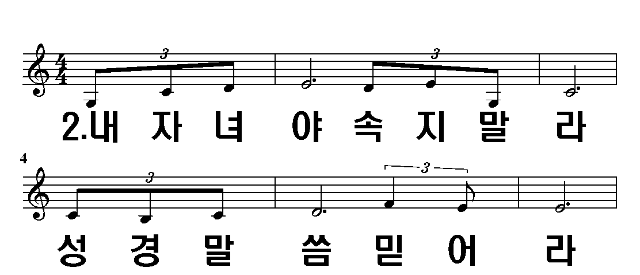
1 – 1
2 - 5
3 - 9
5/12

Slide 6
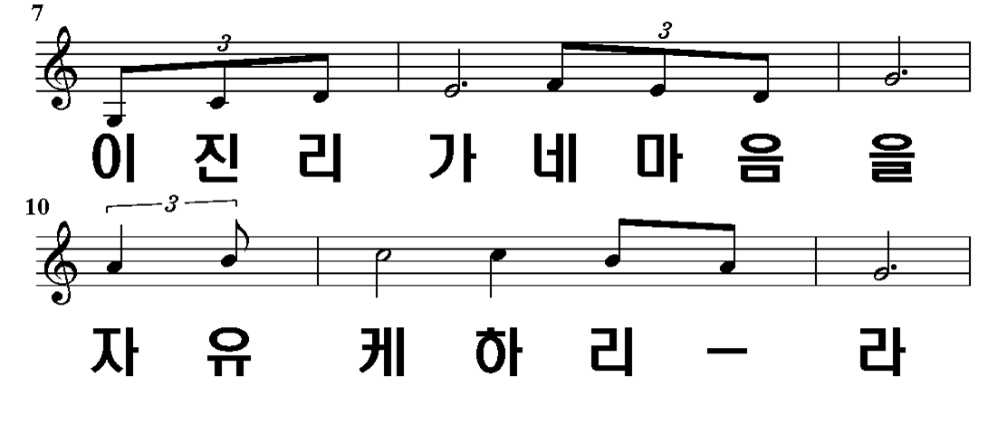
1 – 1
2 - 5
3 - 9
6/12

Slide 7
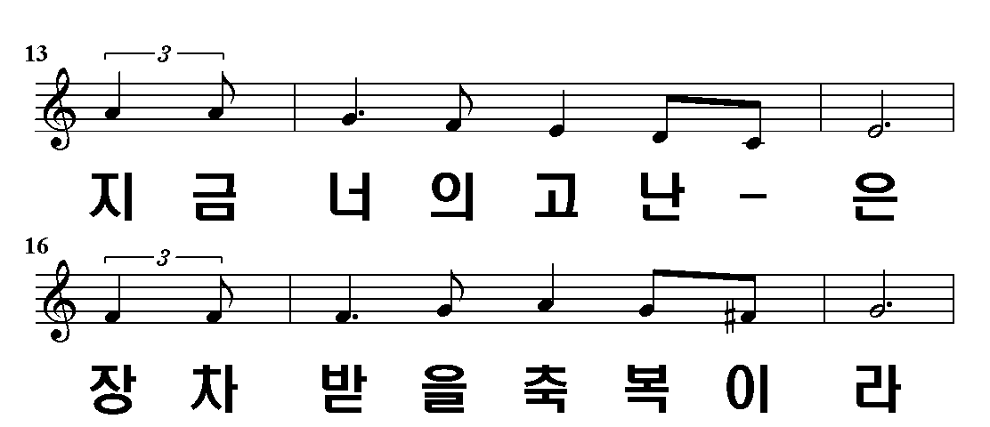
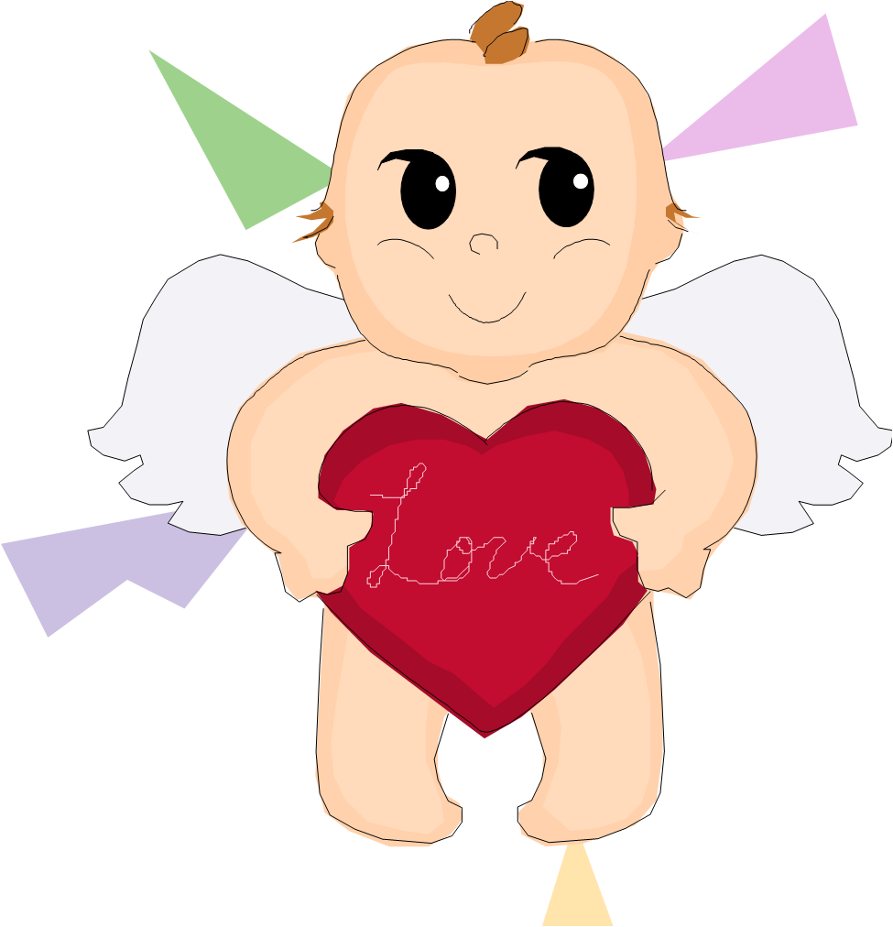
1 – 1
2 - 5
3 - 9
7/12

Slide 8
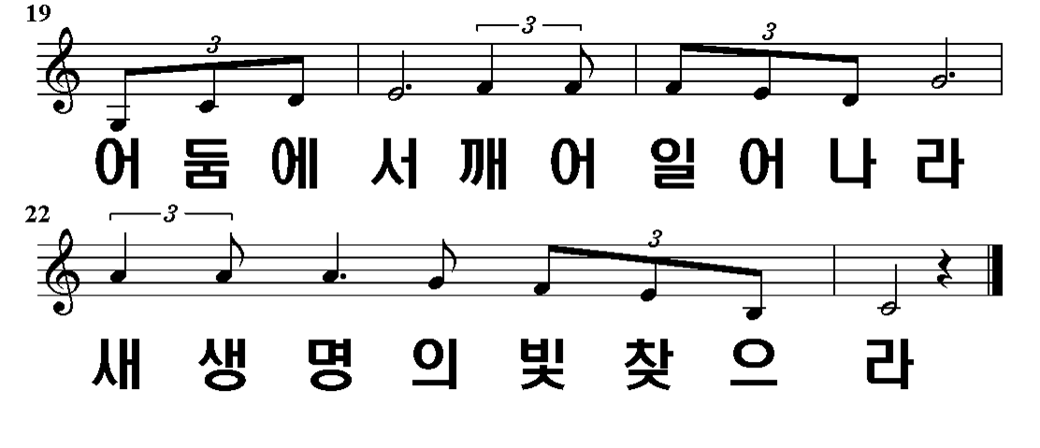
1 – 1
2 - 5
3 - 9
8/12

Slide 9
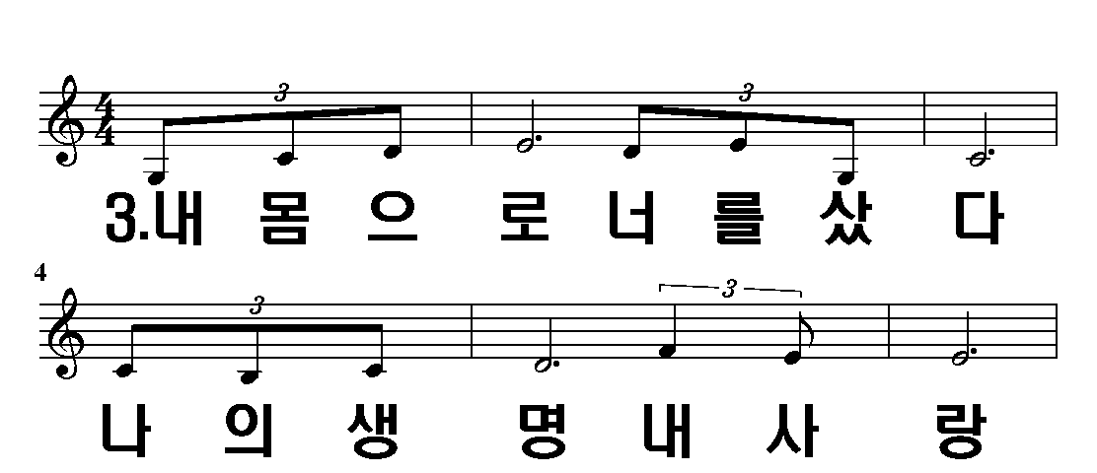
1 – 1
2 - 5
3 - 9
9/12

Slide 10
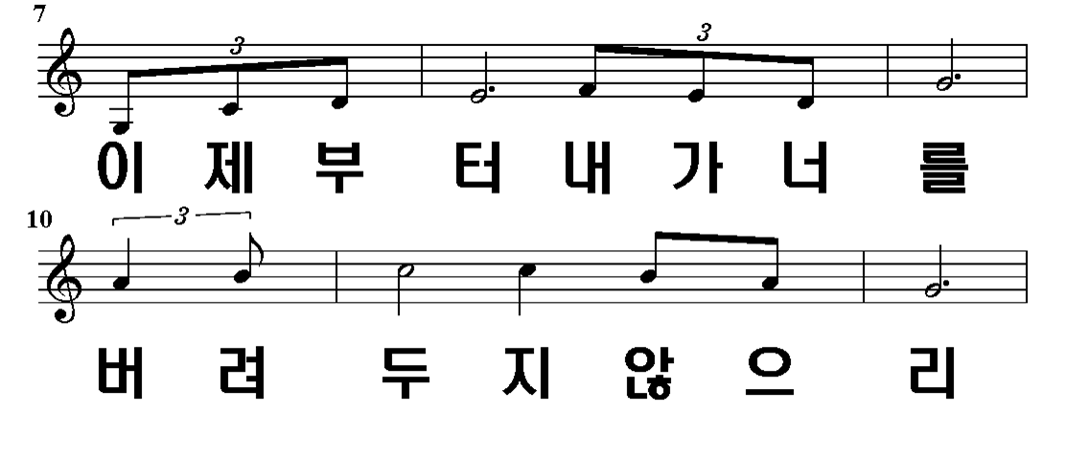
1 – 1
2 - 5
3 - 9
10/12

Slide 11
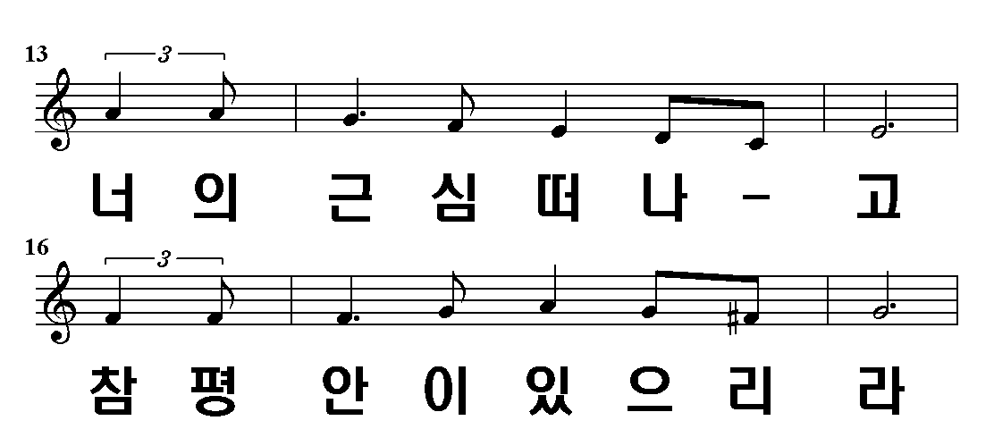
1 – 1
2 - 5
3 - 9
11/12

Slide 12
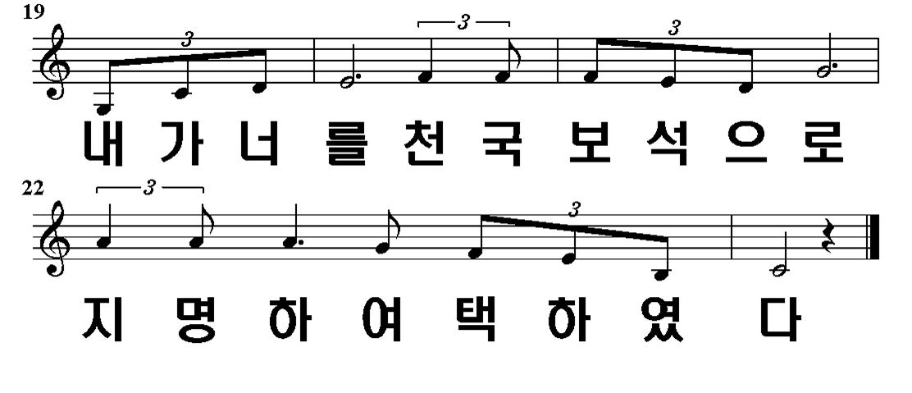
1 – 1
2 - 5
3 - 9
12/12

