Slide 1
나의 안식처는 오직 예수
1/19

Slide 2
2/19

Slide 3
3/19

Slide 4
4/19

Slide 5
5/19

Slide 6
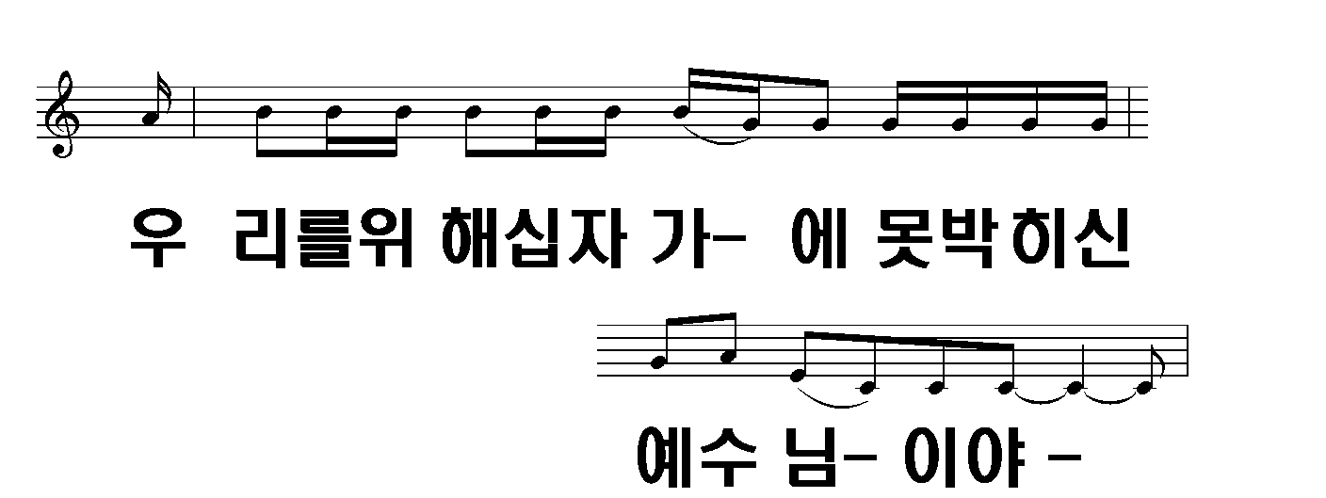
6/19

Slide 7
7/19

Slide 8
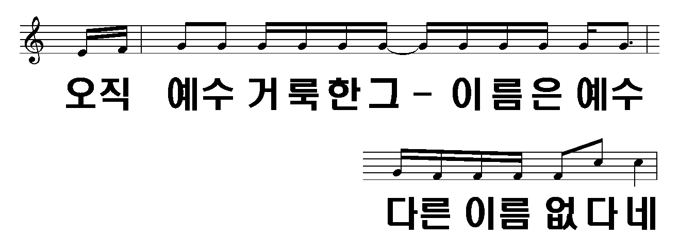
8/19

Slide 9
9/19

Slide 10
10/19

Slide 11
11/19

Slide 12
12/19

Slide 13
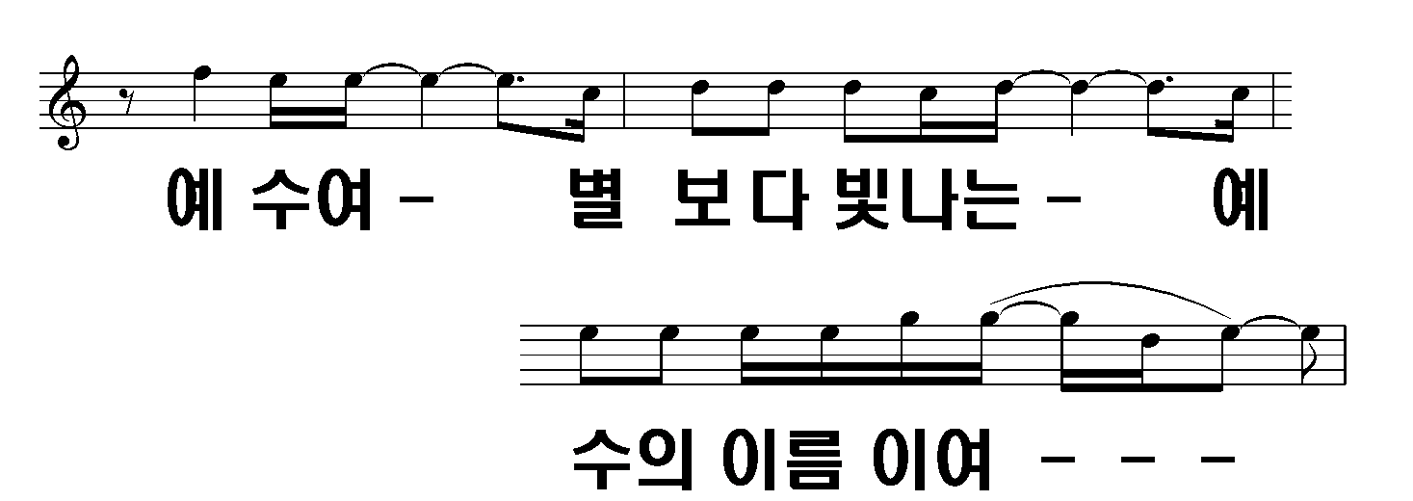
13/19

Slide 14
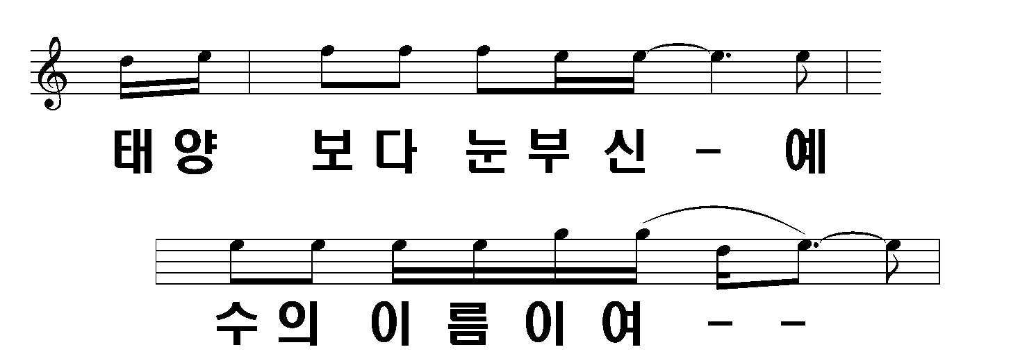
14/19

Slide 15
15/19

Slide 16
16/19

Slide 17
17/19

Slide 18
18/19

Slide 19
19/19

