Slide 1
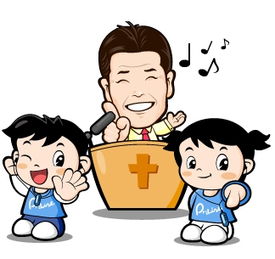
그리워요 성령님
1절
1/10

Slide 2
2/10

Slide 3
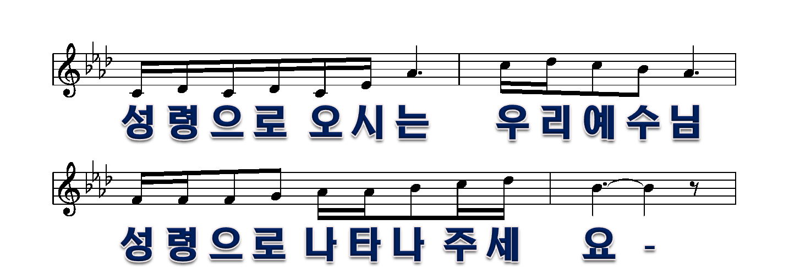
3/10

Slide 4
4/10

Slide 5
5/10

Slide 6
2절
6/6

Slide 7
7/10

Slide 8
8/10

Slide 9
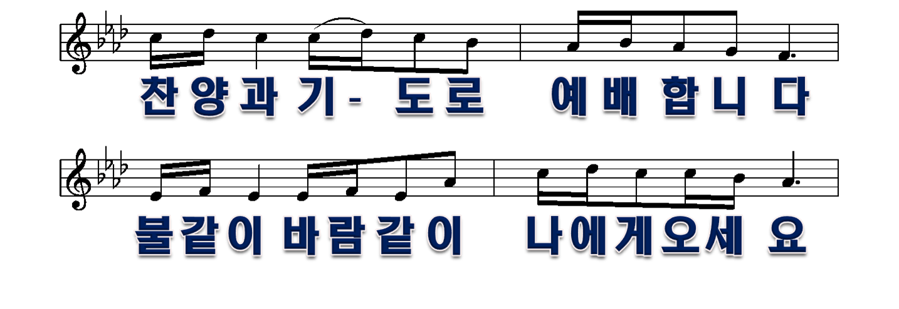
9/10

Slide 10
10/10

