Slide 1
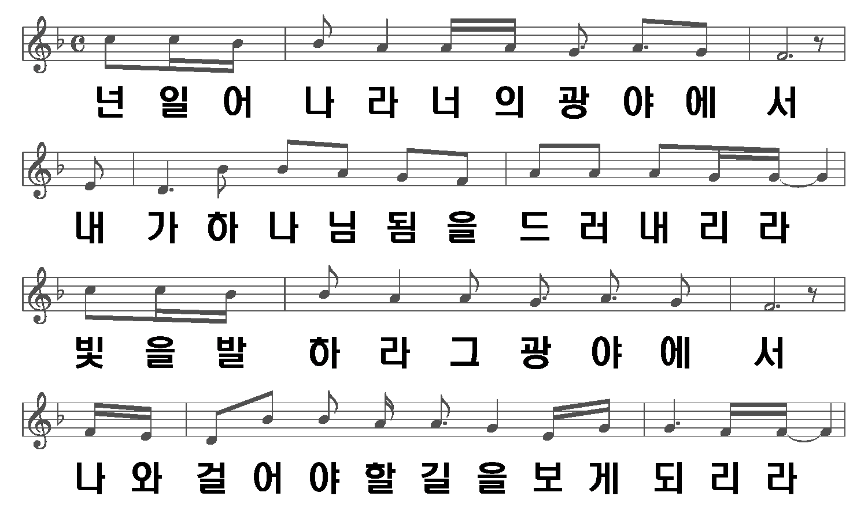
광야를 지나며
1/6

Slide 2
2/6

Slide 3
3/6

Slide 4
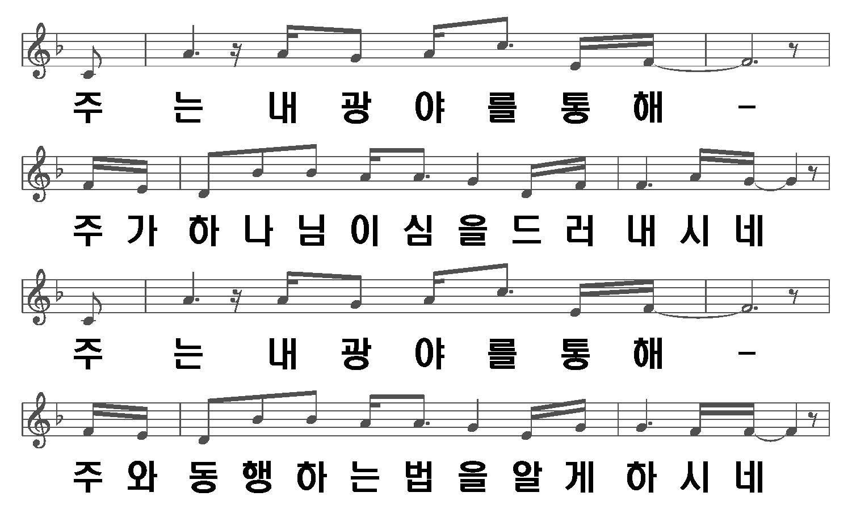
4/6

Slide 5
5/6

Slide 6
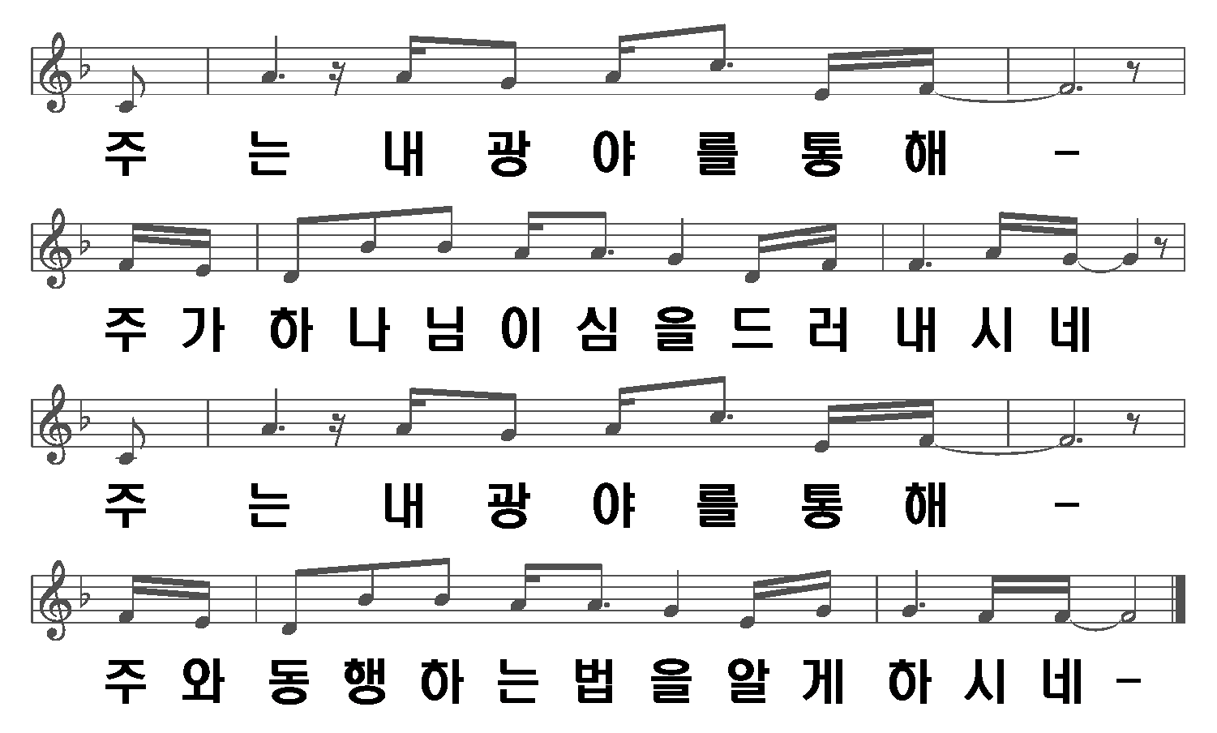
6/6

